Slide 1
RVfpga
The Complete Course in Understanding Computer Architecture

Slide 2
RVfpga Introduction

Slide 3












Acknowledgements
AUTHORS
Prof. Sarah Harris
Prof. Daniel Chaver
Zubair Kakakhel
M. Hamza Liaqat
CONTRIBUTORS
Robert Owen
Olof Kindgren
Prof. Luis Piñuel
Ivan Kravets
Valerii Koval
Ted Marena
Prof. Roy Kravitz
Prof. Peng Liu
ASSOCIATES
Prof. José Ignacio Gómez
Prof. Christian Tenllado
Prof. Daniel León
Prof. Katzalin Olcoz
Prof. Alberto del Barrio
Prof. Fernando Castro
Prof. Manuel Prieto
Prof. Francisco Tirado
Prof. Román Hermida
Prof. Julio Villalba
Prof Ataur Patwary
Cathal McCabe
Dan Hugo
Braden Harwood
Prof. David Burnett
Gage Elerding
Prof. Brian Cruickshank
Deepen Parmar
Thong Doan
Oliver Rew
Niko Nikolay
Guanyang He
Prof. Peng Liu
ADVISER
Prof. David Patterson
Sponsors and Supporters

Slide 4
RVfpga Introduction
RISC-V FPGA (RVfpga): course that shows how to:
Target SweRV commercial RISC-V core & system-on-chip (SoC) to FPGA
Program the RISC-V SoC
Add more functionality to the RISC-V SoC
Analyze and modify the RISC-V core and memory hierarchy
The package is being developed by Imagination Technologies and its academic and industry partners.
After completing the RVfpga Course, users will walk away with a commercial RISC-V processor, SoC, and ecosystem that they understand and know how to use and modify.
This section of slides covers material in the Getting Started Guide (GSG) Section 1.

Slide 5
Two RVfpga Courses
Imagination Technologies offers two courses based on the RISC-V architecture:
RVfpga: the course covered in these slides, about the RISC-V core, memory system, and peripherals
RVfpga-SoC: a second course that shows how to:
Build a RISC-V SoC from building blocks
Install the Zephyr RTOS (real-time operating system)
Run programs on Zephyr
Run simple Tensorflow programs
(RVfpga-SoC is not covered in these slides)

Slide 6
Download Material from Imagination Technologies
Both courses (RVfpga and RVfpga-SoC) are available as separate downloads (free upon registration) at:
https://university.imgtec.com/rvfpga/
This EdX course covers the RVfpga Course.

Slide 7
RVfpga Audience & Track Record
Target Audience
Undergraduates and master’s students in electrical engineering, computer science, or computer engineering
Academics & industry professionals interested in learning the RISC-V architecture
Imagination University Programme (IUP) Track Record: Developed MIPSfpga Program:
Launched in April 2015
Engaged 800 universities
Winner: Elektra Best Educational Support Award, Europe 2015

Slide 8
RVfpga Course Overview

Slide 9
RVfpga Course
Typically 2-3 Semester Course
Undergraduate (Labs 1-10)
Master’s / upper division (Labs 11-20)
Expected Prior Knowledge
Digital design
High-level programming (preferably C)
Instruction set architecture / assembly programming
Microarchitecture
Memory systems
This material is covered in Digital Design and Computer Architecture: RISC-V Edition, Harris & Harris, © Elsevier 2021.
These topics are expanded on with hands-on learning throughout RVfpga course.
This section of slides covers material in the Getting Started Guide (GSG) Section 1.

Slide 10

Textbook
Recommended text to understand before starting the RVfpga course: Digital Design and Computer Architecture: RISC-V Edition, Harris & Harris, © Elsevier, 2021
ISBN-10: 0128200642 ISBN-13: 978-0128200643

Slide 11

RVfpga System
Open-source core from Western Digital
2-way superscalar core
9-stage pipeline
In-order
RV32IMC

Slide 12
RVfpga Required Software and Hardware
SOFTWARE
Xilinx Vivado 2019.2 WebPACK
PlatformIO – an extension of Microsoft’s Visual Studio Code – with Chips Alliance platform, which includes: RISC-V Toolchain, OpenOCD, Verilator HDL Simulator, WD Whisper instruction set simulator (ISS) Verilator and GTKWave
HARDWARE*
Digilent’s Nexys A7 / Nexys 4 DDR FPGA Board
*Optional: All labs can be completed in simulation only; so this hardware is recommended but not required.
RISC-V CORE & SOC
Core: Western Digital’s SweRV EH1**
SoC: Chips Alliance’s SweRVolf**
**Open-source – and provided as part of RVfpga package.
All are free except the optional Nexys A7 FPGA board, which costs $265 (academic price: $199)

Slide 13
Nexys A7-100T FPGA Board: Optional
Contains Artix-7 field programmable gate array (FPGA)
Includes peripherals (i.e., LEDs, switches, pushbuttons, 7-segment displays, accelerometer, temperature sensor, microphone, etc.)
Available for purchase at digkey.com, digilentinc.com, and other vendors
We will support the Basys3 FPGA board soon.
Figure of board from https://reference.digilentinc.com/

Slide 14
Supported Platforms
Operating Systems
Ubuntu 18.04 and 20.04
Windows 10
macOS

Slide 15
RVfpga Course Overview

Slide 16
Introduction
The RVfpga System is an extension of Chips Alliance’s SweRVolf SoC, which is based on Western Digital’s RISC-V SweRV EH1 core.
The source code for the SoC and core are provided with the RVfpga download from Imagination Technologies.
The RVfpga System is also simply referred to as “RVfpga”.
This section of slides covers material in the Getting Started Guide (GSG) Section 1.

Slide 17
RVfpga Hierarchy
SweRV EH1 Core / Core Complex
Includes processor, memory, and bus interface
SweRVolfX SoC
Extended version of SweRVolf
Adds peripherals
RVfpga System
RVfpgaNexys: SweRVolfX targeted to hardware (Nexys A7 FPGA board, with on-board memory, clock, etc.)
RVfpgaSim: SweRVolfX targeted to simulation

Slide 18
RVfpga Hierarchy
Name | Description
SweRV EH1 Core | Open-source commercial RISC-V core developed be Western Digital (https://github.com/chipsalliance/Cores-SweRV).
SweRV EH1 Core Complex | SweRV EH1 core with added memory (ICCM, DCCM, and instruction cache), programmable interrupt controller (PIC), bus interfaces, and debug unit (https://github.com/chipsalliance/Cores-SweRV).
SweRVolfX (Extended SweRVolf) | The System on Chip that we use in the RVfpga course. It is an extension of SweRVolf. SweRVolf (https://github.com/chipsalliance/Cores-SweRVolf): An open-source SoC built around the SweRV EH1 Core Complex. It adds a boot ROM, UART interface, system controller, interconnect (AXI Interconnect, Wishbone Interconnect, and AXI-to-Wishbone bridge), and an SPI controller. SweRVolfX: It adds 4 new peripherals to SweRVolf: a GPIO, a PTC, an additional SPI and a controller for the 8 digit 7-Segment Displays.

Slide 19
RVfpga Hierarchy
Name | Description
RVfpgaNexys | The SweRVolfX SoC targeted to the Nexys A7 board and its peripherals. It adds a DDR2 interface, CDC (clock domain crossing) unit, BSCAN logic (for the JTAG interface), and clock generator. RVfpgaNexys is the same as SweRVolf Nexys (https://github.com/chipsalliance/Cores-SweRVolf), except that the latter is based on SweRVolf.
RVfpgaSim | The SweRVolfX SoC with a testbench wrapper and AXI memory intended for simulation. RVfpgaSim is the same as SweRVolf sim, (https://github.com/chipsalliance/Cores-SweRVolf), except that the latter is based on SweRVolf.

Slide 20
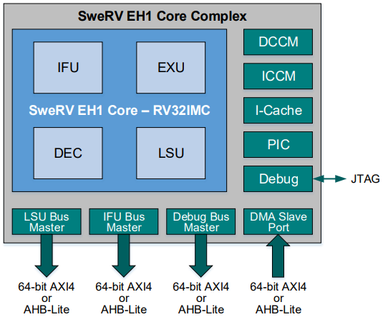
SweRV EH1 Core and SweRV EH1 Core Complex
Open-source core from Western Digital
32-bit (RV32ICM) superscalar core, with dual-issue 9-stage pipeline
Separate instruction and data memories (ICCM and DCCM) tightly coupled to the core
4-way set-associative I$ with parity or ECC protection
Programmable Interrupt Controller
Core Debug Unit compliant with the RISC-V Debug specification
System Bus: AXI4 or AHB-Lite
Figure from https://github.com/chipsalliance/Cores-SweRV/blob/master/docs/RISC-V_SweRV_EH1_PRM.pdf

Slide 21
SweRVolfX SoC
Open-source system-on-chip (SoC) from Chips Alliance
SweRVolf uses the SweRV EH1 Core. SweRVolf includes a Boot ROM, UART, and a System Controller and an SPI controller (SPI1)
SweRVolfX extends SweRVolf with another SPI controller (SPI2), a GPIO (General Purpose Input/Output), 8-digit 7-Segment Displays and a PTC (shown in red).
SweRV EH1 Core uses an AXI bus and peripherals use a Wishbone bus, so the SoC also has an AXI to Wishbone Bridge
System | Address
Boot ROM | 0x80000000 - 0x80000FFF
System Controller | 0x80001000 - 0x8000103F
SPI1 | 0x80001040 - 0x8000107F
SPI2 | 0x80001100 - 0x8000113F
Timer | 0x80001200 - 0x8000123F
GPIO | 0x80001400 - 0x8000143F
UART | 0x80002000 - 0x80002FFF
SweRVolfX Memory Map

Slide 22
RVfpgaNexys
RVfpgaNexys: SweRVolfX SoC targeted to Nexys A7 FPGA board with added peripherals:
Core & System:
SweRVolfX SoC
Lite DRAM controller
Clock Generator, Clock Domain
and BSCAN logic for the JTAG port
Peripherals used on Nexys A7 FPGA board:
DDR2 memory
UART via USB connection
SPI Flash memory
16 LEDs and 16 switches
SPI Accelerometer
8-digit 7-segment displays

Slide 23
RVfpgaSim
RVfpgaSim is the SweRVolfX SoC wrapped in a testbench to be used by HDL simulators.

Slide 24
RVfpga System Extensions
The SweRVolfX SoC is further extended in Labs 6-10:
Another GPIO controller to interface with the on-board Nexys A7 pushbuttons
Modification of the 7-segment displays controller
New timer modules for using the on-board tri-color LEDs
New external interrupt sources

Slide 25
RVfpga Labs Overview

Slide 26
RVfpga Labs Overview
Part 1: Labs 1-10
Programming
Vivado Project & I/O Systems
Part 2: Labs 11-20
RISC-V Core
RISC-V Memory Systems
RISC-V Benchmarking & Performance Monitoring
All labs include exercises for using and/or modifying the RVfpga System to increase understanding through hands-on design. RVfpga includes C and assembly example programs and solutions.

Slide 27
RVfpga Labs 1-4: Programming
Lab 1: C Programming: Write a C program in PlatformIO, and run / debug it on RVfpgaNexys/RVfpgaSim/Whisper. Also introduce Western Digital’s Board Support and Platform Support Packages (BSP and PSP) for supporting operations such as printing to the terminal.
Lab 2: RISC-V Assembly Language: Write a RISC-V assembly program in PlatformIO and run /debug it on RVfpgaNexys/RVfpgaSim/Whisper.
Lab 3: Function Calls: Introduction to function calls, C libraries, and the RISC-V calling convention.
Lab 4: Image Processing: C & Assembly: Embed assembly code with C code.

Slide 28
RVfpga Labs 5-10: I/O & Peripherals
Lab 5: Creating a Vivado Project: Build a Vivado project to target RVfpgaNexys to an FPGA board and simulate RVfpgaSim in Verilator.
Lab 6: Introduction to I/O: Introduction to memory-mapped I/O and the RVfpga System’s open-source GPIO module.
Lab 7: 7-Segment Displays: Build a 7-segment display decoder and integrate it into the RVfpga System.
Lab 8: Timers: Understand and use Timers and a Timer controller.
Lab 9: Interrupt-driven I/O: Introduction to the RVfpga System’s interrupt support and use of interrupt-driven I/O.
Lab 10: Serial Buses: Introduction to serial interfaces (SPI, I2C, and UART). Show how to use the onboard accelerometer that uses an SPI interface.

Slide 29
RVfpga Labs 11-20: The RISC-V Core
Lab 11: Understanding the SweRV EH1 configuration, core structure, and performance monitoring.
Labs 12, 13, 16: Examining instruction flow through the pipeline (Arithmetic/Logic, Memory, Jumps, and Branches).
Labs 14-16: Understanding hazards and how to deal with them
Lab 16: Understanding and modifying the branch predictor
Lab 17: Exploring superscalar execution.
Lab 18: Adding new instructions and hardware counters.
Lab 19: Understanding the memory hierarchy and I$.
Lab 20: Enabling the ICCM and DCCM (instruction and data closely-coupled memories) and using benchmarking to compare performance.

Slide 30
Directories Hierarchy

Slide 31
Directory hierarchy of RVfpga materials
RVfpga/Documents folder: Documents (GSG, Slides, Labs, …).
LabInstructions folder:
Instructions for each Lab + Figures used in the instructions for each lab.
RVfpga/verilatorSIM folder: Sources for Verilator simulator
RVfpga/src folder: Verilog sources for the SoC
RVfpga/examples folder: PlatformIO projects for the GSG examples
RVfpga/Labs folder:
Folders Lab1,…, Lab20: Resources to be used while completing the labs.
RVfpgaLabsSolutions folder: Exercise solutions for each of the labs.
ProgramsAndDocuments folder: Solutions for the proposed tasks and exercises.
Modified_RVfpgaSystem folder: Modified RVfpga System as guided by the exercises in Labs 6-10 and Lab 18. Solutions for the exercises + Instructions.

Slide 32
RVfpga Installing Tools

Slide 33
RVfpga Software Tools (Section 5 GSG)
Xilinx’s Vivado IDE
View RVfpga source files (Verilog / SystemVerilog) and hierarchy
Create bitfile (FPGA configuration file) for RVfpga targeted to Nexys A7 board
Visual Studio Code (VSCode) + PlatformIO
PlatformIO: an extension of VSCode
Download the RVfpga System onto the Nexys A7 board
Compile, download, run, and debug C and assembly programs on the RVfpga System
Verilator – an HDL (hardware description language) simulator
Simulate the RVfpga System at HDL (low) level to analyze its internal signals
GTKWave – wave viewer
This section of slides covers material in the Getting Started Guide (GSG) Sections 2 & 5.

Slide 34
Installation of minimal tools (Section 2 GSG)
VSCode
Download VSCode for Linux, Windows or MacOS
Install it in your system
Install PlatformIO on top of VSCode
In Linux: Install python3 utilities
Extensions Icon: Look for PlatformIO and install it
Install Nexys A7 drivers:
Linux: Use provided folder
Windows: Use Zadig application (Appendix)
Mac OS: Not necessary
Install GTKWave following the instructions for your OS

Slide 35
Initial Examples

Slide 36
LEDs-Switches – Execution on the Board (Sections 6.A and 6.E of GSG)
Connect the Nexys A7 board.
Open VSCode and PlatformIO.
Click on File → Open Folder and select:
[RVfpgaPath]\RVfpga\examples\LedsSwitches_C-Lang
Analyse the source code of the program: src/LedsSwitches_C-Lang.c.
The first time an RVfpga example opens in PlatformIO, the Chips Alliance platform gets automatically installed. It includes the pre-built RISC-V toolchain, OpenOCD, the Verilator simulator, etc.
Download RVfpgaNexys to the Nexys A7 board. You first have to update the path. You may need to refresh the Project Tasks window.
Download and execute example LEDs-Switches.
This section of slides covers material in the Getting Started Guide (GSG) Sections 6-8.

Slide 37
AL_Operations Example – Execution on the Board (Section 6.B of GSG)
If not opened yet, open VSCode and PlatformIO
Click on File → Close Folder from the top file menu. Then click on File → Open Folder and select:
[RVfpgaPath]\RVfpga\examples\AL_Operations
Analyse the source code of the program
If necessary, download RVfpgaNexys to the Nexys A7 board.
Download, execute and debug example AL_Operations.

Slide 38
AL_Operations Example – Simulation in Whisper (Section 8 of GSG)
Click on File → Open File and double-click on [RVfpgaPath]/RVfpga/examples/AL_Operations/platformio.ini, and set whisper as the debug tool by uncommenting line 17.
Launch the debugger as usual
You can now debug the program exactly as you did in Section 6.B, but this time the program is running in simulation on Whisper instead of on the Nexys A7 FPGA board.

Slide 39
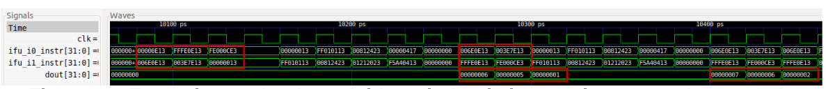
AL_Operations Example – Simulation in Verilator (Section 7 of GSG)
Open file platformio.ini. Establish the path to RVfpgaSim.
Run the simulation by clicking on the PlatformIO icon
Expand Project Tasks → env:swervolf_nexys → Platform and click on Generate Trace
A few seconds after the previous step, file trace.vcd should have been generated and you can open it with GTKWave
Add signals: click on File – Read Tcl Script File and select [RVfpgaPath]/RVfpga/examples/AL_Operations/test.tcl

Slide 40
HelloWorld Example (Section 6.F of GSG)
Open VSCode and PlatformIO. Click on File → Close Folder. Click on File → Open Folder from the top file menu and select:
[RVfpgaPath]\RVfpga\examples\HelloWorld_C-Lang
Configure the system:
PlatformIO serial monitor: Use monitor_speed parameter in file platformio.ini
In Linux, add yourself to the dialout, tty and uucp groups
Download and execute example HelloWorld. When the program starts to run, open the serial monitor, by clicking on the plug button available on the bottom of VS Code.

Slide 41
HelloWorld – Simulation in Whisper (Section 8 of GSG)
Click on File → Open File and double-click on [RVfpgaPath]/RVfpga/examples/HelloWorld_C-Lang/platformio.ini, and set whisper as the debug tool by uncommenting line 17.
Launch the debugger as usual. You can now debug the program exactly as you did in Section 6.B, but this time the program is running in simulation on Whisper instead of on the Nexys A7 FPGA board.
Given that this program uses the printfNexys function in Whisper, you should not open the PlatformIO serial monitor, as messages are shown in the DEBUG console instead.

Slide 42
Lab 1: C Programming

Slide 43
RVfpga Lab 1: C Programming
Create PlatformIO project from scratch
Add example C programs to the project:
LedsSwitches
HelloWorld
Run and debug the two programs:
On the board
On Whisper
Complete the exercises at end of lab

Slide 44
RVfpga Lab 1: Memory-Mapped I/O Addresses
Device | Memory-Mapped I/O Address
Switches (16 on Nexys A7 board) | 0x80001400 (upper 16 bits)
LEDs (16 on Nexys A7 board) | 0x80001404 (lower 16 bits)
Input/Output of GPIO (1 = output, 0 = input) | 0x80001408

Slide 45
RVfpga Lab 1: Example C Program
// memory-mapped I/O addresses
#define GPIO_SWs 0x80001400
#define GPIO_LEDs 0x80001404
#define GPIO_INOUT 0x80001408
#define READ_GPIO(dir) (*(volatile unsigned *)dir)
#define WRITE_GPIO(dir, value) { (*(volatile unsigned *)dir) = (value); }
int main ( void )
{
int En_Value=0xFFFF, switches_value; // Upper 16 bits are inputs, lower 16 are outputs
WRITE_GPIO(GPIO_INOUT, En_Value);
while (1) {
switches_value = READ_GPIO(GPIO_SWs); // read value on switches
switches_value = switches_value >> 16; // shift into lower 16 bits
WRITE_GPIO(GPIO_LEDs, switches_value); // display switch value on LEDs
}
return(0);
}
This program writes the value of the switches to the LEDs.
Folder Location: [RVfpgaPath]\RVfpga\examples\LedsSwitches_C-Lang

Slide 46
RVfpga Lab 1: Western Digital’s BSP & PSP
Western Digital provides:
PSP: platform support package
BSP: board support package
These provide common functions for a given processor (SweRV EH1 core) and board (Nexys A7 FPGA board).
Example: printfNexys (like printf function in C)

Slide 47

RVfpga Lab 1: Using UART to Print to Terminal
#if defined(D_NEXYS_A7)
#include <bsp_printf.h>
#include <bsp_mem_map.h>
#include <bsp_version.h>
#else
PRE_COMPILED_MSG("no platform was defined")
#endif
#include <psp_api.h>
#define DELAY 10000000
int main(void) {
int i, j = 0;
// Initialize UART
uartInit();
while (1) {
printfNexys("Hello RVfpga users! Iteration: %d\n", j);
for (i=0; i < DELAY; i++) ; // delay between printf's
j++;
}
}
Add this line to platformio.ini file:
monitor_speed = 115200
After program starts running, open PlatformIO terminal by pressing this button in the bottom of the window:
Folder Location: [RVfpgaPath]\RVfpga\examples\HelloWorld_C-Lang

Slide 48
RVfpga Lab 1: Exercises Sample – Input/Output
Exercise 1. Write a C program that flashes the value of the switches onto the LEDs. The value should pulse on and off slow enough that a person can view the flashing.
Exercise 2. Write a C program that displays the inverse value of the switches on the LEDs. For example, if the switches are (in binary): 0101010101010101, then the LEDs should display: 1010101010101010; if the switches are: 1111000011110000, then the LEDs should display: 0000111100001111...
Exercise 4. Write a C program that displays the unsigned 4-bit addition of the 4 least significant bits of the switches and the 4 most significant bits of the switches. Display the result on the 4 least significant (right-most) bits of the LEDs. The fifth bit of the LEDs should light up when unsigned overflow occurs (that is when the carry out is 1).

Slide 49
RVfpga Lab 1: Exercises Sample – Algorithms
Exercise 5. Write a C program that finds the greatest common divisor of two numbers, a and b, according to the Euclidean algorithm. The values a and b should be statically defined variables in the program.
Exercise 9. Implement the bubble sort algorithm in C. This algorithm sorts the components of a vector in ascending order by means of the following procedure:
Traverse the vector repeatedly until done.
Interchanging any pair of adjacent components if V(i) > V(i+1).
The algorithm stops when every pair of consecutive components is in order.
Exercise 10. Write a program in C that computes the factorial of a given non-negative number, n, by means of iterative multiplications. While you should test your program for multiple values of n, your final submission should be for n = 7. The program should print out the value of factorial(n) at the end of the program. n should be a variable that is statically defined within the program.

Slide 50
Lab 2: RISC-V Assembly

Slide 51
RVfpga Lab 2: RISC-V Assembly Programming
Create PlatformIO project from scratch
Add example RISC-V Assembly program to the project:
LedsSwitches
Run and debug the program:
On the board
On Whisper
Complete the exercises at end of lab
Create a project from scratch

Slide 52
RVfpga Lab 2: RISC-V Assembly Instructions
Common RISC-V Assembly Instructions & Pseudoinstructions
RISC-V Assembly | Description | Operation
add s0, s1, s2 | Add | s0 = s1 + s2
sub s0, s1, s2 | Subtract | s0 = s1 - s2
addi t3, t1, -10 | Add immediate | t3 = t1 – 10
mul t0, t2, t3 | 32-bit multiply | t0 = t2 * t3
div s9, t5, t6 | Division | t9 = t5 / t6
rem s4, s1, s2 | Remainder | s4 = s1 % s2
and t0, t1, t2 | Bit-wise AND | t0 = t1 & t2
or t0, t1, t5 | Bit-wise OR | t0 = t1 | t5
xor s3, s4, s5 | Bit-wise XOR | s3 = s4 ^ s5
andi t1, t2, 0xFFB | Bit-wise AND immediate | t1 = t2 & 0xFFFFFFFB
ori t0, t1, 0x2C | Bit-wise OR immediate | t0 = t1 | 0x2C
xori s3, s4, 0xABC | Bit-wise XOR immediate | s3 = s4 ^ 0xFFFFFABC
sll t0, t1, t2 | Shift left logical | t0 = t1 << t2
srl t0, t1, t5 | Shift right logical | t0 = t1 >> t5
sra s3, s4, s5 | Shift right arithmetic | s3 = s4 >>> s5
slli t1, t2, 30 | Shift left logical immediate | t1 = t2 << 30
srli t0, t1, 5 | Shift right logical immediate | t0 = t1 >> 5
srai s3, s4, 31 | Shift right arithmetic immediate | s3 = s4 >>> 31

Slide 53
RVfpga Lab 2: RISC-V Assembly Instructions
Common RISC-V Assembly Instructions & Pseudoinstructions (continued)
RISC-V Assembly | Description | Operation
lw s7, 0x2C(t1) | Load word | s7 = memory[t1+0x2C]
lh s5, 0x5A(s3) | Load half-word | s5 = SignExt(memory[s3+0x5A]_{15:0})
lb s1, -3(t4) | Load byte | s1 = SignExt(memory[t4-3]_{7:0})
sw t2, 0x7C(t1) | Store word | memory[t1+0x7C] = t2
sh t3, 22(s3) | Store half-word | memory[s3+22]_{15:0} = t3_{15:0}
sb t4, 5(s4) | Store byte | memory[s4+5]_{7:0} = t4_{7:0}
beq s1, s2, L1 | Branch if equal | if (s1==s2), PC = L1
bne t3, t4, Loop | Branch if not equal | if (s1!=s2), PC = Loop
blt t4, t5, L3 | Branch if less than | if (t4 < t5), PC = L3
bge s8, s9, Done | Branch if not equal | if (s8>=s9), PC = Done
li s1, 0xABCDEF12 | Load immediate | s1 = 0xABCDEF12
la s1, A | Load address | s1 = Variable A’s memory address (location)
nop | Nop | no operation
mv s3, s7 | Move | s3 = s7
not t1, t2 | Not (Invert) | t1 = ~t2
neg s1, s3 | Negate | s1 = -s3
j Label | Jump | PC = Label
jal L7 | Jump and link | PC = L7; ra = PC + 4
jr s1 | Jump register | PC = s1

Slide 54
RVfpga Lab 2: RISC-V Registers
32 32-bit registers
Name | Register Number | Use
zero | x0 | Constant value 0
ra | x1 | Return address
sp | x2 | Stack pointer
gp | x3 | Global pointer
tp | x4 | Thread pointer
t0-2 | x5-7 | Temporary variables
s0/fp | x8 | Saved variable / Frame pointer
s1 | x9 | Saved variable
a0-1 | x10-11 | Function arguments / Return values
a2-7 | x12-17 | Function arguments
s2-11 | x18-27 | Saved variables
t3-6 | x28-31 | Temporary variables

Slide 55
RVfpga Lab 2: Example RISC-V Assembly Program
// memory-mapped I/O addresses
# GPIO_SWs = 0x80001400
# GPIO_LEDs = 0x80001404
# GPIO_INOUT = 0x80001408
.globl main
main:
li t0, 0x80001400 # base address of GPIO memory-mapped registers
li t1, 0xFFFF # set direction of GPIOs
# upper half = switches (inputs) (=0)
# lower half = outputs (LEDs) (=1)
sw t1, 8(t0) # GPIO_INOUT = 0xFFFF
repeat:
lw t1, 0(t0) # read switches: t1 = GPIO_SWs
srli t1, t1, 16 # shift val to the right by 16 bits
sw t1, 4(t0) # write value to LEDs: GPIO_LEDs = t1
j repeat # repeat loop
This program writes the value of the switches to the LEDs.
Folder Location: [RVfpgaPath]\RVfpga\Labs\Lab02

Slide 56
RVfpga Lab 2: Same Exercises as in Lab 1 - Sample
Exercise 4. Write a C program that displays the unsigned 4-bit addition of the 4 least significant bits of the switches and the 4 most significant bits of the switches. Display the result on the 4 least significant (right-most) bits of the LEDs. The fifth bit of the LEDs should light up when unsigned overflow occurs (that is when the carry out is 1).

Slide 57
Lab 3: Function Calls

Slide 58
RVfpga Lab 3: Function Calls
Write C programs with function (procedure) calls
Write C programs with calls to library functions:
Use of standard libraries
Use of WD libraries, specific for RVfpga
RISC-V (Procedure) Calling Convention

Slide 59
RVfpga Lab 3: Example Program with Functions
// memory-mapped I/O addresses
#define GPIO_SWs 0x80001400
#define GPIO_LEDs 0x80001404
#define GPIO_INOUT 0x80001408
#define READ_GPIO(dir) (*(volatile unsigned *)dir)
#define WRITE_GPIO(dir, value) { (*(volatile unsigned *)dir) = (value); }
void IOsetup();
unsigned int getSwitchVal();
void writeValtoLEDs(unsigned int val);
int main ( void ) {
unsigned int switches_val;
IOsetup();
while (1) {
switches_val = getSwitchVal();
writeValtoLEDs(switches_val);
}
return(0);
}

Slide 60
RVfpga Lab 3: Example Program with Functions
void IOsetup()
{
int En_Value=0xFFFF;
WRITE_GPIO(GPIO_INOUT, En_Value);
}
unsigned int getSwitchVal()
{
unsigned int val;
val = READ_GPIO(GPIO_SWs); // read value on switches
val = val >> 16; // shift into lower 16 bits
return val;
}
void writeValtoLEDs(unsigned int val)
{
WRITE_GPIO(GPIO_LEDs, val); // display val on LEDs
}

Slide 61
RVfpga Lab 3: C Libraries
Libraries
Collection of commonly used functions
Provided so that common functions are readily available (save programming time)
Example C libraries:
math.h (math library): includes functions such as sqrt (square root), cos (cosine), etc.
stdio.h (standard I/O library): includes functions for printing values to the screen (printf), reading values from users (scanf), etc.
stdlib.h (standard library): includes functions for generating random numbers (rand).
Many others… (google C libraries)

Slide 62
RVfpga Lab 3: Example Program using C Library
#include <stdlib.h>
...
int main(void) {
unsigned int val;
volatile unsigned int i;
IOsetup();
while (1) {
val = rand() % 65536;
writeValtoLEDs(val);
for (i = 0; i < DELAY; i++)
;
}
return(0);
}
This program writes a random number between 0 and 65535 to the LEDs.

Slide 63
RVfpga Lab 3: WD Libraries
We’ve used printfNexys in many programs
Lab 9: Use of WD functions for handling interrupts

Slide 64
RVfpga Lab 3: RISC-V Calling Convention
Call a function
jal function_label
Return from a function
jr ra
Arguments
placed in registers a0-a7
Return value
placed in register a0

Slide 65
RVfpga Lab 3: RISC-V Calling Convention Example
C Code
int main() {
...
int y = y + func1(1, 2, 3)
y++;
...
}
int func1(int a, int b, int c) {
int sum;
sum = a + b + c;
return sum;
}
RISC-V Assembly
# y is in s0
main:
...
addi a0, zero, 1 # put values in argument registers
addi a1, zero, 2
addi a2, zero, 3
jal func1 # call function func1
add s0, s0, a0 # y = y + return value
addi s0, s0, 1 # y = y++
...
# sum is in s0
func1:
add s0, a0, a1 # sum = a + b
add s0, s0, a2 # sum = a + b + c
addi a0, s0, 0 # return value = sum
jr ra # return

Slide 66
RVfpga Lab 3: The Stack
Scratch space in memory used to save register values
The stack pointer (sp) holds the address of the top of the stack
The stack grows downward in memory. So, for example, to make space for 4 words (16 bytes) on the stack the following code is used:
addi sp, sp, -16
Two categories of registers:
Preserved registers: register contents must be preserved across function calls (i.e., contain the same value before and after a function call)
Non-preserved registers: register contents must not be preserved across function calls (i.e., the register does not need to be the same before and after a function call)
Saved registers (s0-s11), the return address register (ra), and the stack pointer (sp) are preserved registers. All other registers are not preserved.

Slide 67
RVfpga Lab 3: Preserved / Nonpreserved Registers
Name | Register Number | Use | Preserved
zero | x0 | Constant value 0 | -
ra | x1 | Return address | Yes
sp | x2 | Stack pointer | Yes
gp | x3 | Global pointer | -
tp | x4 | Thread pointer | -
t0-2 | x5-7 | Temporary variables | No
s0/fp | x8 | Saved variable / Frame pointer | Yes
s1 | x9 | Saved variable | Yes
a0-1 | x10-11 | Function arguments / Return values | No
a2-7 | x12-17 | Function arguments | No
s2-11 | x18-27 | Saved variables | Yes
t3-6 | x28-31 | Temporary variables | No

Slide 68
RVfpga Lab 3: The Stack – Revised Assembly Code
C Code
int main() {
...
int y = y + func1(1, 2, 3)
y++;
...
}
int func1(int a, int b, int c) {
int sum;
sum = a + b + c;
return sum;
}
RISC-V Assembly
# y is in s0
main: ...
addi a0, zero, 1 # put values in argument registers
addi a1, zero, 2
addi a2, zero, 3
jal func1 # call function func1
add s0, s0, a0 # y = y + return value
addi s0, s0, 1 # y = y++
...
# sum is in s0
func1:addi sp, sp, -4 # make room on stack
sw s0, 0(sp) # save s0 on stack
add s0, a0, a1 # sum = a + b
add s0, s0, a2 # sum = a + b + c
addi a0, s0, 0 # return value = sum
lw s0, 0(sp) # restore s0 from stack
addi sp, sp, 4 # restore stack pointer
jr ra # return

Slide 69
RVfpga Lab 3: Exercises Sample – C programs
Exercise 3. Write a C program that measures reaction time. Your program should time how long it takes for a person to switch on the right-most switch (SW[0]) after all of the LEDs light up. You will use the rand() function from the stdlib.h library to generate a random amount of time to delay between each time the user attempts to test their reaction time.

Slide 70
RVfpga Lab 3: Exercises Sample – Assembly programs
Exercise 8. Write a RISC-V assembly program called Filter.S (the program must be compliant with the standard for function management studied before). You can use the following pseudo-code:
#define N 6
int i, j=0, A[N]={48,64,56,80,96,48}, B[N];
for (i=0; i<(N-1); i++){
if( (myFilter(A[i],A[i+1])) == 1){
B[j]=A[i]+ A[i+1] + 2;
j++;
}
}
Write the equivalent RISC-V assembly code, including any directives required to reserve memory space, and declaring the corresponding sections (.data, .bss and .text). Function myFilter returns the value 1 if the first argument is a multiple of 16 and the second is greater than the first; otherwise, it returns a 0.
Write the assembly code of the function myFilter.

Slide 71
Lab 4: C and Assembly

Slide 72
RVfpga Lab 4: Combining C and Assembly
Example: Image processing program
Some functions written in C and some in assembly
Convert colour image to greyscale

Slide 73
RVfpga Lab 4: Image Processing Program
Each pixel stored as three 8-bit colours: R = red, G = green, B = blue
Any colour can be created by varying R, G, and B values
To convert image to an 8-bit greyscale (grey), each pixel is transformed as follows:
grey = (306*R + 601*G + 117*B) >> 10
RGB weights add up to 1024 (306 + 601 + 117 = 1024), so to get back to an 8-bit range (0-255), the result is divided by 1024 (i.e., shifted right by 10 bits: >> 10)
For more details about the algorithm, see:
https://www.mathworks.com/help/matlab/ref/rgb2gray.html

Slide 74
RVfpga Lab 4: Assembly Function
.globl makes CoulourToGrey_Pixel function visible to all files in project
.globl ColourToGrey_Pixel
.text
ColourToGrey_Pixel:
li x28, 306 # a0 = R * 306
mul a0, a0, x28
li x28, 601 # a1 = G * 601
mul a1, a1, x28
li x28, 117 # a2 = B * 117
mul a2, a2, x28
add a0, a0, a1 # grey = a0 + a1 + a2
add a0, a0, a2
srl a0, a0, 10 # grey = grey / 1024
ret # return
.end
grey = (306*R + 601*G + 117*B) >> 10

Slide 75
RVfpga Lab 4: Structs and Arrays
typedef struct {
unsigned char R;
unsigned char G;
unsigned char B;
} RGB;
extern unsigned char VanGogh_128x128[]; // 1D array of individual RGB values
RGB ColourImage[N][M]; // 2D array of RGB struct (colour image)
unsigned char GreyImage[N][M]; // 2D array of greyscale image
// VanGogh_128.c
unsigned char VanGogh_128x128[] = { 157, // R (pixel [0][0])
182, // G (pixel [0][0])
161, // B (pixel [0][0])
171, // R (pixel [0][1])
195, // G (pixel [0][1])
173, // B (pixel [0][1])
173, // R (pixel [0][2])
... }

Slide 76
RVfpga Lab 4: Main Function
int main(void) {
// Create an N x M matrix using the input image
initColourImage(ColourImage);
// Transform Colour Image to Grey Image
ColourToGrey(ColourImage,GreyImage);
...
}
void ColourToGrey(RGB Colour[N][M], unsigned char Grey[N][M]) {
int i,j;
for (i=0; i<N; i++)
for (j=0; j<M; j++)
Grey[i][j] = ColourToGrey_Pixel(Colour[i][j].R, Colour[i][j].G,
Colour[i][j].B);
}

Slide 77
RVfpga Lab 4: Provided project and Exercises
Exercise 1. Execute the program on a different input image.
Exercise 2. Create a C function that counts the number of close to white (>235) and close to black (<20) elements in the VanGogh greyscale image. Print the two numbers on the serial console.
Exercise 3. Transform the ColourToGrey_Pixel assembly subroutine into a C function, and the C function ColourToGrey into an assembly subroutine that invokes the ColourToGrey_Pixel C function.
Exercise 4. Apply a Blur Filter to the VanGogh colour image.

Slide 78
Lab 5: Vivado Project

Slide 79
RVfpga Lab 5: RVfpga Vivado Project
Vivado is a Xilinx tool for viewing, modifying, and synthesizing the source (Verilog) code for the RVfpga System.
RVfpga System’s source code is in:
[RVfpgaPath]/RVfpga/src
In this lab, users create a Vivado project that contains RVfpga System’s source code, synthesize RVfpgaNexys targeted to Nexys A7 board and create a bitfile that contains information to configure the FPGA as RVfpgaNexys.
Vivado (and Verilator) are used extensively in RVfpga Labs 6-20 for modifying and simulating the RVfpga System.

Slide 80
Lab 6: Intro to I/O

Slide 81
RVfpga Lab 6: Introduction to I/O
Main features of a general-purpose I/O system and the one used in the RVfpga System
Simplified theoretical version of a generic GPIO controller
GPIO controller used in the SweRVolfX SoC:
We first analyse its high-level specification and introduce fundamental exercises
We then analyse its low-level implementation, simulating RVfpgaSim in Verilator, and introducing advanced exercises

Slide 82
RVfpga Lab 6: Generic Processor with I/O

Slide 83
RVfpga Lab 6: General-Purpose I/O (GPIO)
General-purpose I/O:
Allows processor to read/write pins connected to peripherals (like switches and LEDs)
Each pin can be configured as an input or output using tri-state
Three memory-mapped registers:
Read Register: value read from pin
Write Register: value to write to pin
Enable Register: 1 = output, 0 = input
Peripherals

Slide 84
RVfpga Lab 6: SweRVolfX GPIO Module
GPIO Module from OpenCores
https://opencores.org/projects/gpio
Allows up to 32 GPIO pins
All pins can be individually configured as inputs (enable = 0) or outputs (enable = 1)
Configuration can change throughout program
Register | Memory-Mapped Address
Read Register | 0x80001400
Write Register | 0x80001404
Enable Register | 0x80001408

Slide 85
RVfpga Lab 6: Memory-Mapped Registers
Mapping LEDs & Switches to GPIO pins:
LEDS: pins [15:0] (outputs of processor)
Switches: pins [31:16] (inputs to processor)
Configure GPIO:
Enable Register = 0x0000FFFF (1 = output, 0 = input)
li t0, 0x80001400
li t1, 0xFFFF
sw t1, 8(t0) # Enable Register = 0xFFFF
Write LEDs:
Write value in [15:0] to address 0x80001404
sw t3, 4(t0) # LEDs = [t3]_{15:0}
Read Switches:
Read switches in bits [31:16] from address 0x80001400
Shift right by 16 bits to put value in lower 16 bits
lw t5, 0(t0) # [t5]_{31:16} = switch values
srli t5, t5, 16 # [t5]_{15:0} = switch values
figure of board from https://reference.digilentinc.com/

Slide 86
RVfpga Lab 6: Fundamental Exercises - Sample
Exercise 1. Write a RISC-V assembly program and a C program that shows a block of four lit LEDs that repeatedly moves from one side of the 16 LEDs available on the board to the other. Also include two switches that control the speed and direction. Switch[0] changes the speed and Switch[1] changes the direction as follows:
If Switch[0] is ON (high), the lit LEDs should move quickly. Otherwise, the lit LEDs should move slowly. You may define what “quickly” and “slowly” mean, but either speed must be visible, and you must be able to detect a difference in speed just by looking at it.
If Switch[1] is ON (high), the lit LEDs should repeatedly move from right-to-left (they start back at the right when they reach the left-most LED). Otherwise, the lit LEDs should repeatedly move from left-to-right.

Slide 87
RVfpga Lab 6: GPIO Low-Level Implementation
Divided in 3 main parts
RVfpgaNexys’s external connection to the on-board LEDs/Switches (left shaded region)
Integration of the GPIO module into SweRVolfX (middle shaded region)
Connection between the GPIO and the SweRV EH1 (right shaded region)

Slide 88
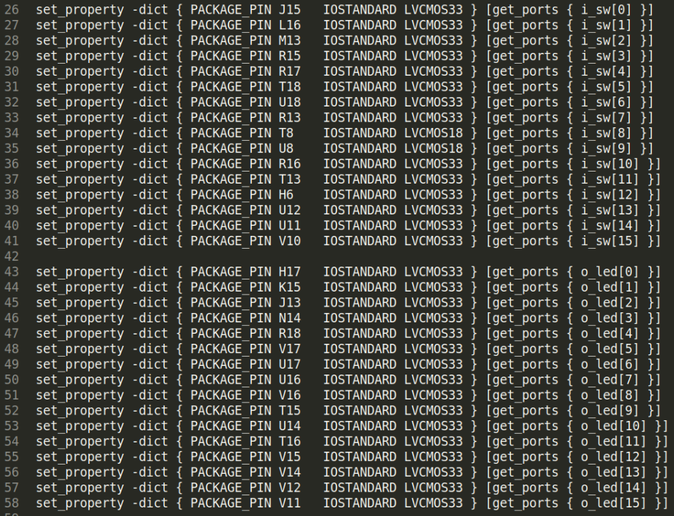
RVfpga Lab 6: External connection
File rvfpganexys.xdc: Defines the connection of i_sw[15:0] with the on-board switches and o_led[15:0] with the on-board LEDs

Slide 89
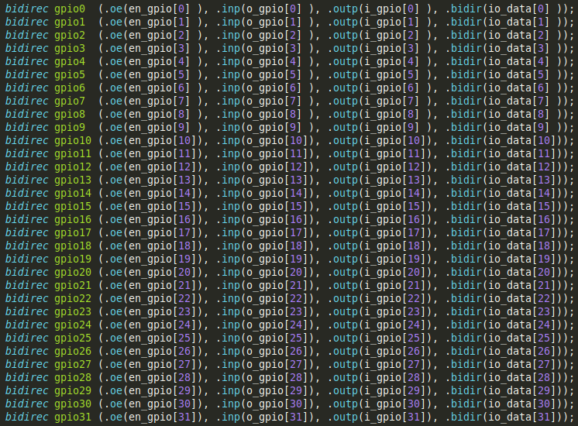
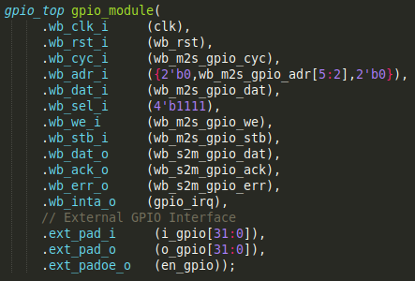
RVfpga Lab 6: Integration into RVfpga
File swervolf_core.v: Tri-state buffers and GPIO module instantiation

Slide 90
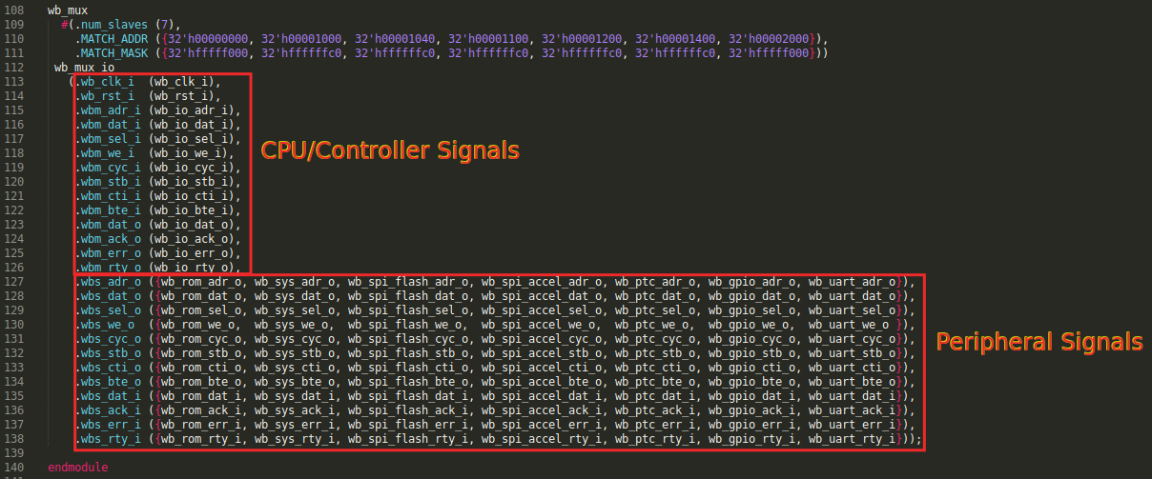
RVfpga Lab 6: Connection with SweRV EH1
File wb_intercon.v: 7-1 Multiplexer implementation

Slide 91
RVfpga Lab 6: Advanced Exercises - Sample
Exercise 3. Expand RVfpgaNexys to support the five on-board pushbuttons. The pushbuttons are shown in Figure 22. The five buttons are named according to their location: up, down, left, right, and center – BTNU, BTND, BTNL, BTNR, BTNC.
Exercise 5. Write a RISC-V assembly program and a C program that displays an increasingly incrementing binary count on the LEDs, starting at 1. Use BTNC to change the speed of the count, and BTNU to restart the count whenever it is pressed.

Slide 92
Lab 7: 7-Segment Displays

Slide 93
RVfpga Lab 7: 7-Segment Displays
Describes how the RVfpga System was extended to work with 7-segment displays and shows how to modify the 7-segment display controller.
We first describe how the 7-segment display controller works
Then we analyse the high-level specification of the 8-digit 7-segment display controller included in the RVfpga System and provide some fundamental exercises.
Finally, we analyse the low-level implementation of this controller, perform a Verilator simulation and provide additional exercises where you will modify and experiment with the controller implementation.

Slide 94
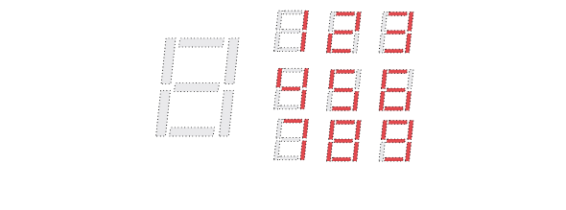
RVfpga Lab 7: Overview of 7-Segment Displays
7 LED segments: A-G
Light up segments to create digit
1: segments B and C
2: segments A, B, D, E, G
3: segments A, B, C, D, G
etc.
A
F
B
G
E
D
C

Slide 95
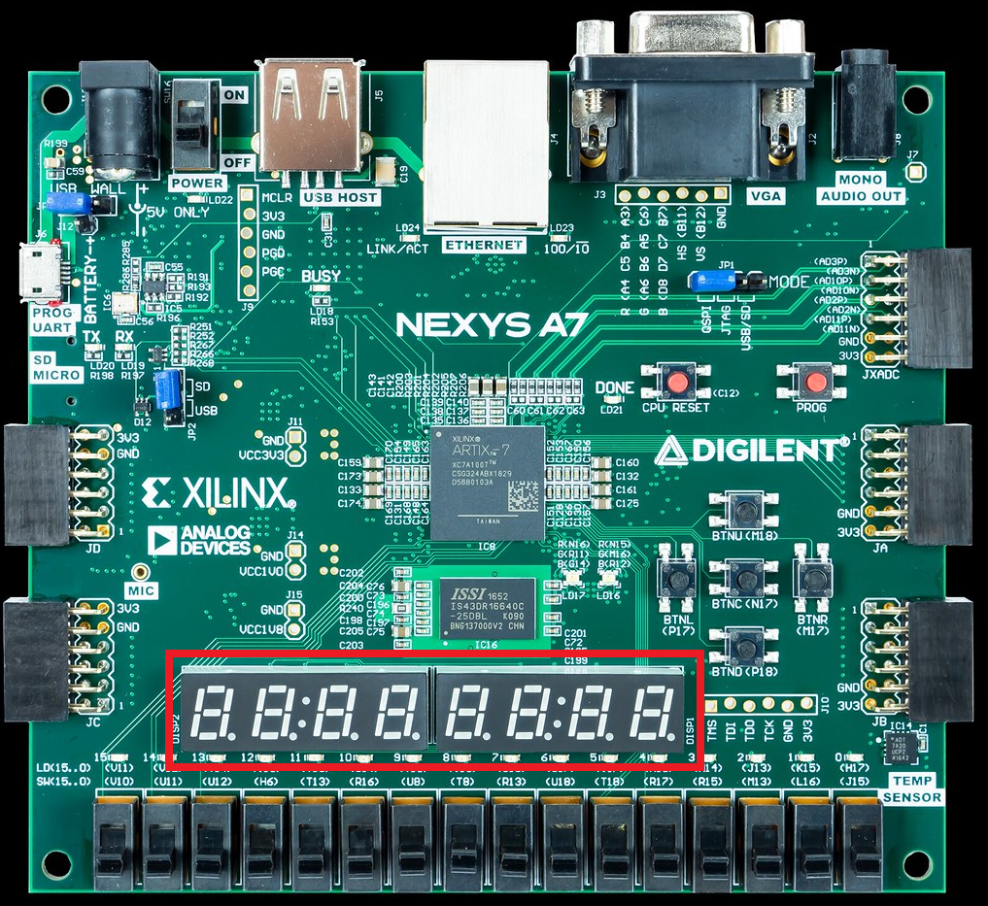
RVfpga Lab 7: 7-Segment Displays on Nexys A7
8-digit 7-segment displays
Memory-mapped access:
Enables_Reg: 0x80001038
Digits_Reg: 0x8000103C
Enables are low-asserted
Example: Display 71 on two right-most digits:
Enables_Reg = 0xFC (0b11111100: enable two right-most digits)
Digits_Reg = 0x71
Assembly: li t0, 0x80001038
li t1, 0xFC
li t2, 0x71
sw t1, 0(t0)
sw t2, 4(t0)
figure of board from https://reference.digilentinc.com/

Slide 96
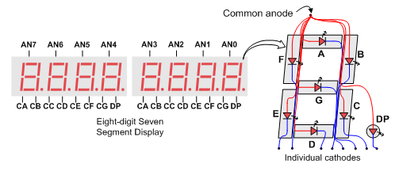
RVfpga Lab 7: 7-Segment Display Hardware
Each digit is common anode (anodes of that digit’s LEDs are tied together)
Anode signals act as enables (AN0 - AN7)
Drive low to enable digit (AN0 - AN7 go through an inverter (not shown) before being fed to LED)
Each segment for all digits is tied together
Segments are driven low to turn them on
Time-multiplexing of AN0 - AN7 signals allows unique values to be displayed on each digit
A digit’s AN signal (AN0 - AN7) must go low every 1-16 ms to be bright
8-Digit 7-Segment Displays

Slide 97
RVfpga Lab 7: Fundamental Exercises - Sample
Exercise 1. Write a RISC-V assembly program and a C program that shows the value of the switches on the four right-most digits of the 7-segment displays.
Exercise 2. Write a RISC-V assembly program and a C program that shows the string “0-1-2-3-4-5-6-7-8” moving from the right to the left of the 8-digit 7-segment displays.

Slide 98
RVfpga Lab 7: 7-Seg. Disp. Low-Level Implementation
Three parts:
Connection to 7-segment displays
7-segment displays decoder in System Control (Sys-Con) module
SweRV EH1 bus interface

Slide 99
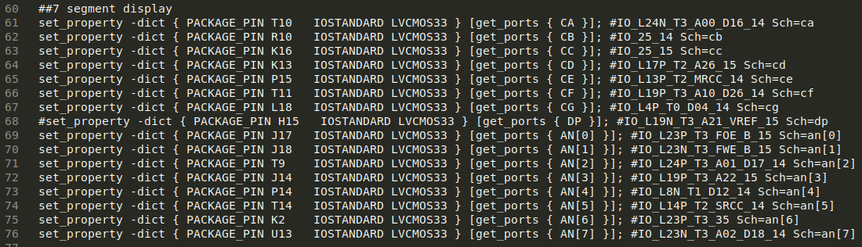
RVfpga Lab 7: External connection
File rvfpganexys.xdc: Defines the connection of CA-CG (called Digits_Bits[i] in the SoC) and AN[i] with the on-board 7-segment displays

Slide 100
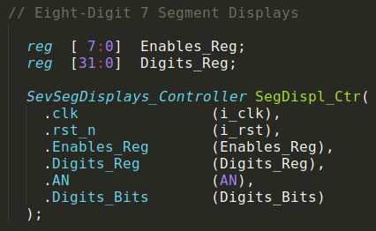
RVfpga Lab 7: Integration into SweRVolfX
File swervolf_syscon.v: 7-segment displays controller instance:
Inputs: i_clk (clock), reset (i_rst)
Memory-mapped inputs: Enables_Reg (which digits on board are enabled), Digits_Reg (number to display)
Outputs: AN (which digit on board to drive), Digits_Bits (which segments to assert).

Slide 101
RVfpga Lab 7: Advanced Exercises - Sample
Exercise 3. Modify the controller described in this lab so that the 8-digit 7-segment displays can show any combination of ON/OFF LEDs.
Exercise 4. Use the new controller for printing the following on the 8-digit 7-segment displays: “I SAY HI”. As usual, implement both RISC-V assembly and C versions of the program.

Slide 102
Lab 8: Timers

Slide 103
RVfpga Lab 8: Timers
Generate precise timing: Timers increment or decrement a counter at a fixed frequency, which is often configurable, and then interrupt the processor when the counter reaches zero or a predefined value.
More sophisticated timers can also perform other functions, such as generating pulse-width modulated (PWM) waveforms to control the speed of a motor or the brightness of a light.
In this lab, we first describe the high-level specification of the timer included in the RVfpga System and then explain its low-level implementation. Both fundamental and advanced exercises are proposed that show how to both use and modify a timer.

Slide 104
RVfpga Lab 8: Timer (PTC) Module
The Timer module used is from OpenCores: https://opencores.org/projects/ptc
Timer module (also called the PTC module) is used for:
Timer/Counter: counts clock edges (or edges of another signal, also called events)
Pulse-width modulation (PWM):
Vary high duration (called duty cycle) of an output
Used to approximate an analog voltage digitally
PWM example: 33% duty cycle (signal is high 1/3rd of the time). If high level is 3 V, analog voltage (average voltage of signal) is 3 V * 0.33 = 1 V

Slide 105
RVfpga Lab 8: Timer (PTC) Registers
Name | Address | Width | Access | Description
RPTC_CNTR | 0x80001200 | 1-32 | R/W | Main PTC counter
RPTC_HRC | 0x80001204 | 1-32 | R/W | PTC HI Reference/Capture register
RPTC_LRC | 0x80001208 | 1-32 | R/W | PTC LO Reference/Capture register
RPTC_CTRL | 0x8000120C | 9 | R/W | Control register
RPTC_CNTR: Counter (value of the counter)
RPTC_HRC: High reference capture – indicates the number of cycles (after reset) when the output should go high in PWM mode
RPTC_LRC: Low reference capture – indicates the number of cycles (after reset) when the count is complete in counter/timer mode; indicates the number of clock cycles (after reset) when the output should go low in PWM mode.
RPTC_CTRL: Control register

Slide 106
RVfpga Lab 8: Timer Example
Set RPTC_LRC to number of cycles to count
Set control bits (RPTC_CTRL) to configure timer:
Reset counter and clear interrupts: RPTC_CTRL = 0xC0 (0b011000000): CNTRRST (bit 7) = 1: counter is reset (RPTC_CNTR = 0); INT (bit 6) = 1: interrupt request cleared.
Enable counter and interrupts: RPTC_CTRL = 0x21 (0b000100001): EN (bit 0) = 1: counter is enabled, so RPTC_CNTR increments; INTE (bit 5) = 1: PTC asserts an interrupt when RPTC_CNTR == RPTC_LRC.
Program reads interrupt bit in control register (INT is bit 6 of RPTC_CTRL) until it is 1 (indicating that RPTC_CNTR == RPTC_LRC).
This algorithm does not use interrupts, but it does read the interrupt bit (INT, bit 6 of RPTC_CTRL) to determine when the correct number of clock cycles have been reached. We show how to use interrupts in Lab 9.

Slide 107
RVfpga Lab 8: Fundamental Exercises - Sample
Exercise 1. Write a program that displays an ascending count on the 8-digit 7-segment displays. The value should change about once per second and, for creating this delay, you must use the timer module.
First, write the program in RISC-V assembly language and run it on the Nexys A7 board.
Then, perform a simulation in Verilator with the same program.
Now write the program in C and run it on the Nexys A7 board.
Simulate your C program in Verilator, as in part (b) for the RISC-V assembly program.

Slide 108
RVfpga Lab 8: Timer Low-Level Implementation
Divided in 2 main parts
(No external connection)
Integration of the Timer module into SweRVolfX (left shaded region)
Connection between the Timer and the SweRV EH1 (right shaded region)

Slide 109
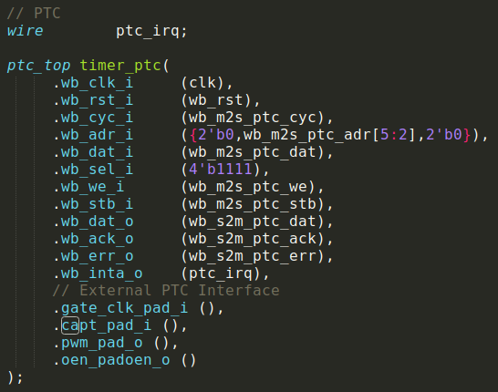
RVfpga Lab 8: Integration into SweRVolfX
File swervolf_core.v: PTC module instantiation

Slide 110
RVfpga Lab 8: Advanced Exercises - Sample
Exercise 2. Modify RVfpgaNexys for connecting the PWM output signal of the timer (pwm_pad_o) to one of the two tri-colour LEDs available on the Nexys A7 board.
Exercise 3. Implement a program that uses the new peripheral for controlling the tri-colour LED, using the value provided by the 16 switches.

Slide 111
Lab 9: Interrupt-Driven I/O

Slide 112
RVfpga Lab 9: Interrupt-Driven I/O
Interrupt-driven I/O vs. Programmed I/O
RVfpga System’s Interrupt Controller
How to configure interrupts using Western Digital’s Platform Support and Board Support Packages (PSP and BSP)
Interrupt Example and Exercises

Slide 113
RVfpga Lab 9: Interrupt-Driven I/O Introduction
Programmed I/O:
Program continuously polls a value (i.e., switches)
Processor busy doing this – instead of other work
Interrupt-driven I/O:
An event (i.e., a switch asserting) makes processor jump to an interrupt service routine (ISR, also called an interrupt handler), which handles the event and then returns to the program.
The processor does other work between events.

Slide 114
RVfpga Lab 9: Handling Interrupts
Interrupts may be caused by hardware or software
In this lab, we focus on hardware interrupts
The SweRV EH1 core handles interrupts after RISC-V’s PLIC (Platform-level interrupt controller) specification. It is referred to as the Programmable Interrupt Controller (PIC). It has:
255 interrupt sources
15 priority levels

Slide 115
RVfpga Lab 9: Interrupt Hardware

Slide 116
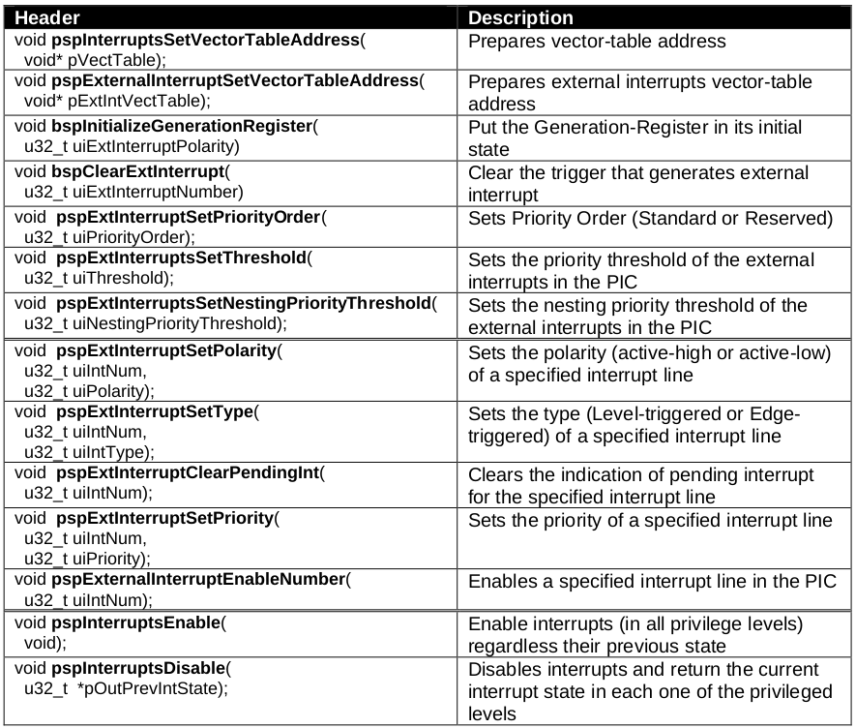
RVfpga Lab 9: WD’s PSP/BSP functions for handling interrupts

Slide 117
RVfpga Lab 9: Interrupt Example using WD’s PSP/BSP
Use interrupts to read value of Switch[0] – only on rising edge (0→1 transition)
Steps for configuring the system using PSP/BSP functions:
Initialize the interrupt system
Initialize external interrupt line IRQ4 and connect with GPIO
Initialize the GPIO registers for using interrupts:
RGPIO_INTE = 0x10000 (enable interrupt for Switch[0])
RGPIO_PTRIG = 0x10000 (interrupt triggered on rising-edge of Switch[0])
RGPIO_INTS = 0x0 (clears all interrupts)
RGPIO_CTRL = 0x1 (enables GPIO interrupts)
Enable global interrupts
GPIO_ISR (see next slide): Invoked when an interrupt is triggered at the GPIO
The current state of the LEDs is read
The LEDs are inverted and masked
The LEDs are written with the new value
The GPIO interrupt is cleared
The IRQ4 external interrupt is cleared
For full code, see: [RVfpgaPath]/RVfpga/Labs/Lab9/LED-Switch_7SegDispl_Interrupts_C-Lang.c

Slide 118
RVfpga Lab 9: Example ISR to invert right-most LED when switch 0→1
void GPIO_ISR(void) {
unsigned int i;
/* Invert LED value */
i = M_PSP_READ_REGISTER_32(GPIO_LEDs); // RGPIO_OUT
i = !i; // Invert the LEDs
i = i & 0x1; // Only change right-most LED
M_PSP_WRITE_REGISTER_32(GPIO_LEDs, i) // RGPIO_OUT
/* Clear GPIO interrupt */
M_PSP_WRITE_REGISTER_32(RGPIO_INTS, 0x0); // RGPIO_INTS
/* Clear this interrupt (IRQ4) */
bspClearExtInterrupt(4);
}

Slide 119
RVfpga Lab 9: Exercises - Sample
Exercise 1. Modify the LED-Switch_7SegDispl_Interrupts_C-Lang program to include a second interrupt source, in this case generated by the timer.
Exercise 2. Modify RVfpgaNexys to include a third interrupt source coming from the second GPIO that you designed in Lab 6 for controlling the on-board pushbuttons (GPIO2).
Exercise 3. Use the extended RVfpgaNexys version that you designed in the previous exercise to implement a C program that displays an increasingly incrementing binary count on the LEDs, starting at 1.
Create a delay with the timer, using interrupts, for waiting between displaying each incremented value so that the values are viewable by the human eye.
Read BTNC and use it to change the speed of the count.
Read Switch[0] and use it to restart the count whenever it is pressed.

Slide 120
Lab 10: Serial Buses

Slide 121
RVfpga Lab 10: Serial Buses
We first describe how serial buses work.
Serial buses send one bit at a time.
Parallel buses send multiple bits at once
Common serial buses
UART (universal asynchronous receiver/transmitter)
SPI (serial peripheral interface)
I2C (inter-integrated circuit protocol)
We then focus on the SPI accelerometer available on the Nexys A7 board:
Analysis of the high-level specification + fundamental exercises
Analysis of the low-level implementation + advanced exercises
More advanced exercises with UART and I2C

Slide 122
RVfpga Lab 10: Serial Buses – SPI
Controller: sends clock, sends & receives data
Peripheral: receives clock, sends & receives data
Signals:
SDO: Serial Data Out
SDI: Serial Data In
SCK: SPI clock
CSbar: low-asserted chip select

Slide 123
RVfpga Lab 10: Serial Buses – SPI
SCK idles
When controller sends an edge on SCK, both the controller and peripheral sample and send data. Data is changed (sent) on falling edge and sampled on rising edge (although this is configurable)

Slide 124
RVfpga Lab 10: RVfpga System’s SPI Module
RVfpga System’s SPI module is from OpenCores
https://opencores.org/projects/simple_spi
4-entry read and write buffers
SPI Registers:
Name | Address | Width | Access | Description
SPCR | 0x80001100 | 8 | R/W | Control register
SPSR | 0x80001108 | 8 | R/W | Status register
SPDR | 0x80001110 | 8 | R/W | Data register
SPER | 0x80001118 | 8 | R/W | Extensions register
SPCS | 0x80001120 | 8 | R/W | CS register

Slide 125
RVfpga Lab 10: SPI ADXL362 Accelerometer
The Nexys A7 board includes an SPI Analog Devices ADXL362 accelerometer. You can find the complete information at:
https://www.analog.com/media/en/technical-documentation/data-sheets/ADXL362.pdf

Slide 126
RVfpga Lab 10: Fundamental Exercises - Sample
Exercise 1. Create a RISC-V assembly program that reads the eight most significant bits of the X-axis, Y-axis, and Z-axis acceleration data and then displays those values on the 8-digit 7-Segment Displays.

Slide 127
RVfpga Lab 10: Accel. Low-Level Implementation
Divided in 3 main parts
RVfpgaNexys external connection to the on-board accelerometer (left shaded region)
Integration of the new SPI module into SweRVolfX (middle shaded region)
Connection between the accelerometer and the SweRV EH1 (right shaded region)

Slide 128
RVfpga Lab 10: External Connection
File rvfpganexys.xdc: Defines the connection of the SPI signals used in the SoC with the corresponding on-board accelerometer pins

Slide 129
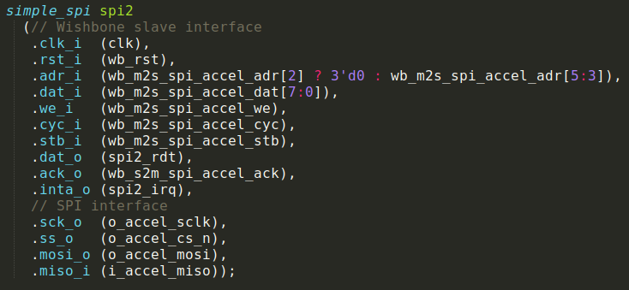
RVfpga Lab 10: Integration into SweRVolfX
File swervolf_core.v: Tri-state buffers and GPIO module instantiation

Slide 130
RVfpga Lab 10: Advanced Exercises - Sample
Exercise 2. The Universal Asynchronous Receiver-Transmitter (UART) is an asynchronous serial communication protocol. First, analyse the low-level implementation of this module in Rvfpga. Then, create a RISC-V assembly program that prints a message to the PlatformIO shell through the serial port.
Exercise 3. Implement the three following functions in the C language:
char uart_getchar(void): This function waits for the keyboard to send a character through the UART to the Nexys A7 board and then returns this character as an output parameter.
int uart_putchar(char c): This function receives a character as an input argument and displays it on the serial console through the UART.
int SevSegDispl(char c): This function receives a character as an input argument and displays it on the right-most digit of the 7-segment displays, shifting the remaining digits one position to the left (the left-most digit is lost).

Slide 131
Labs 11-20 Understanding the Core and Memory Systems

Slide 132
RVfpga Labs 11-20 Overview
Labs 11–20 dive down to the microarchitectural level and analyse how the SweRV EH1 processor and cache/memory hierarchy work.
Each lab is divided into two parts:
Theoretical explanation of the concepts
Illustration of the concepts using figures and a Verilator simulation of an example program to illustrate the concept.
We also provide exercises to deepen understanding of and gain experience with the described concepts.

Slide 133
RVfpga SweRVref
In addition to these 10 labs, which we describe next, the RVfpga_SweRVref document provides extra instructions on the following topics:
Section 1: Sigasi Studio
Section 2: Configuration of the SweRV EH1 processor
Section 3: RVfpga System hierarchy of modules and their most relevant signals
Section 4: Main structures/types for grouping control bits
Section 5: RISC-V compressed instructions
Section 6: Real Benchmarks

Slide 134
Lab 11: SweRV EH1 Configuration, Organization, and Performance Monitoring

Slide 135
RVfpga Lab 11: The SweRV EH1 processor
In this lab we begin to analyse the SweRV EH1 processor. Specifically:
We first describe the Verilog RTL organization and details of each pipeline stage.
We then show how to use the SweRV EH1 performance counters to analyse processor performance.

Slide 136
RVfpga Lab 11: SweRV EH1 Verilog Modules
swerv module: CPU
mem module (memory hierarchy): instruction/data closely-coupled memories (ICCM, DCCM) and instruction cache (I$)

Slide 137
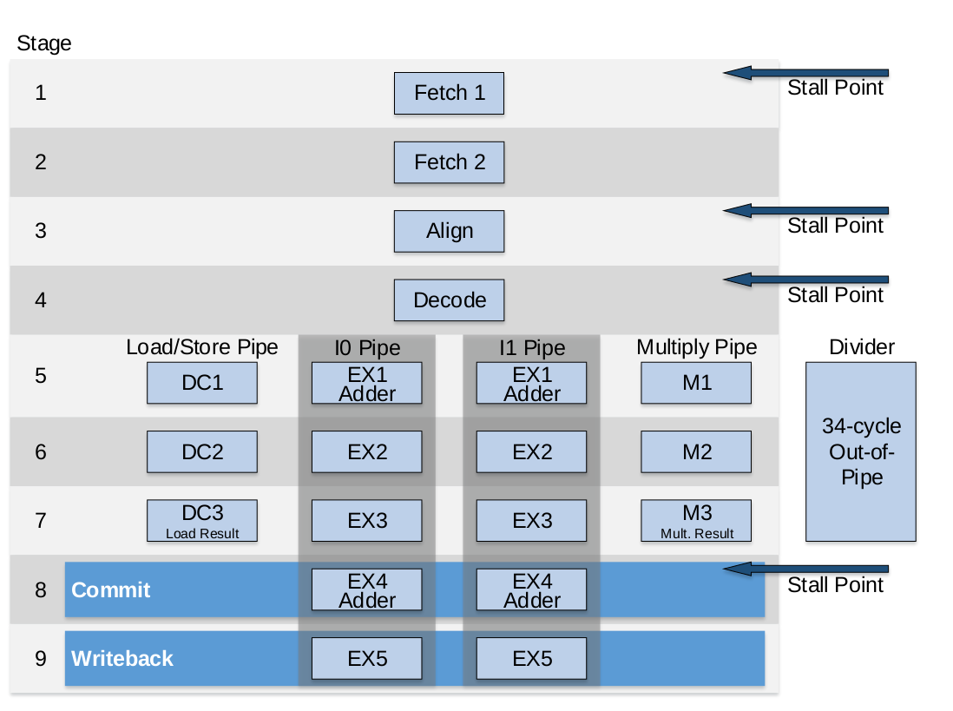
RVfpga Lab 11: The SweRV EH1 Pipeline
SweRV EH1 is a 32-bit 2-way superscalar 9-stage pipelined in-order processor.

Slide 138
RVfpga Lab 11: Fetch (FC1 and FC2) and Align Stages
First three stages: two Fetch stages (FC1 and FC2) and an Align stage

Slide 139
RVfpga Lab 11: Fetch (FC1 and FC2) and Align Stages
In RVfpga, the Instruction Memory consists of:
16 KiB Instruction Cache
128 MiB DDR External Memory
Fetch stages: read instructions from the Instruction Memory
FC1: Computes the instruction address (ifc_fetch_addr_f1)
FC2: Reads instruction from the I$ or the DDR External Memory. (The I$ only caches memory within the Main Memory address range.)
The Align stage performs two main tasks:
Provide two 32-bit instructions per cycle to the Decode stage: Extracts two instructions per cycle from the 128-bit bundles provided by the Instruction Memory and assigns them to each of the two ways available in SweRV EH1.
Uncompress instructions: The Align stage uncompresses 16-bit instructions into 32-bit instructions.

Slide 140
RVfpga Lab 11: Decode, EX1/2/3, Commit and WB Stages
The figure on the next slide shows the last six stages of the pipeline: the Decode stage, three Execution stages, the Commit stage, and the Writeback (WB) stage.

Slide 142
RVfpga Lab 11: Decode Stage
The Decode stage performs two main tasks:
Decode the instructions and generate the control signals (performed by the Control Unit)
Distribute the instructions and operands to the appropriate pipes:
Pipes:
Two Integer pipes: I0 and I1
Multiply pipe
Load/Store pipe (L/S)
Out-of-pipe 34-cycle Divider
Several multiplexers select among possible operands, which may come from:
Bypass logic
Immediate
Register File

Slide 143
RVfpga Lab 11: Execution stages – 3 Pipes and a Divider
The SweRV EH1 processor has the following pipes:
I0/I1 Pipes:
Two integer pipes which have three stages (EX1, EX2, and EX3).
EX1 performs the ALU operation.
Multiply Pipe: The multiply pipe contains a 3-cycle integer multiplier using three stages (M1, M2, and M3).
Load/Store (L/S) Pipe: The L/S pipe executes both load and store instructions.
DC1: an adder calculates the address by adding the register base address and the offset
Divider: The divider is a non-pipelined 34-cycle integer divider.
At the end of the third execution stage (EX3/DC3/M3), the result of the instructions is selected from the proper pipe (I0/I1, MUL, or L/S) using two 3:1 multiplexers, one for each way. The Divider has its own path to the Register File.

Slide 144
RVfpga Lab 11: Commit and Writeback Stages
Commit Stage: Selects the result to write back to the register file.
Writeback Stage:
Writes the results to the Register File using write ports 0 and 1.
The Control Pipeline Registers supply the register identifiers and the enable signals (which were generated in the Decode stage).

Slide 145
RVfpga Lab 11: Example Program – Verilator Simulation
li x28, 0x1
li x29, 0x2
li x30, 0x4
li x31, 0x1
REPEAT:
mul x28, x29, x29 # x28 = 2*2 = 4 (later iterations: 3*3=9, ...)
add x30, x30, x31 # x30 = 4+1 = 5 (later iterations: 5+1=6, ...)
INSERT_NOPS_10
add x29, x29, 1 # x29 = x29 + 1
INSERT_NOPS_10
beq zero, zero, REPEAT # Repeat the loop

Slide 146
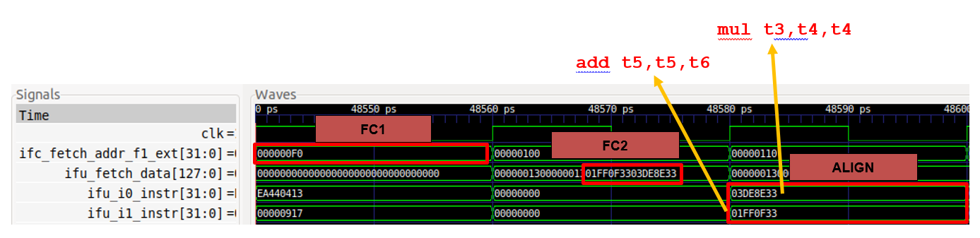
RVfpga Lab 11: Simulation – FC1, FC2, Align Stages

Slide 147
RVfpga Lab 11: Analysis of Simulation
FC1: Computes the address of the mul instruction:
ifc_fetch_addr_f1_ext = 0x000000F0
FC2: Extracts two instructions (shown in red) from the Instruction Memory’s 128-bit bundle:
ifu_fetch_data = 0x000000130000001301FF0F3303DE8E33
Align: The two instructions are extracted and distributed to the two ways of SweRV EH1.
Way 0: ifu_i0_instr = 0x03DE8E33 (mul instruction)
Way 1: ifu_i1_instr = 0x01FF0F33 (add instruction)

Slide 148
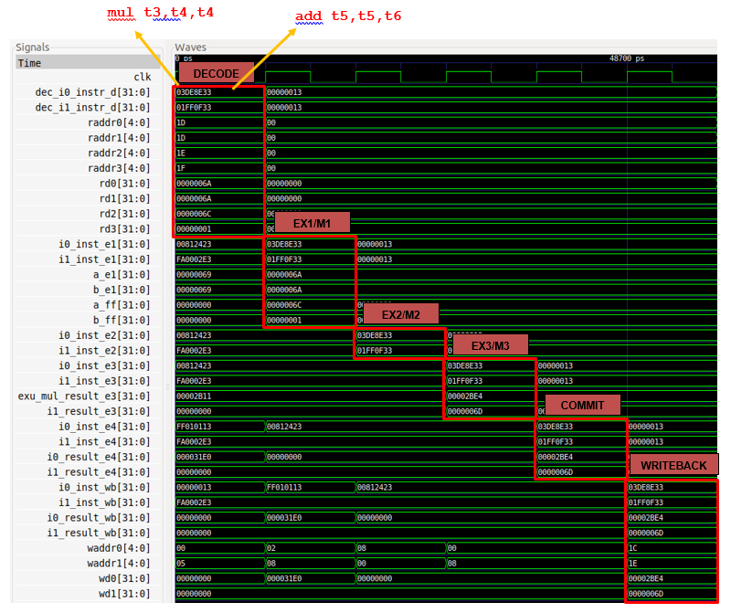
Simulation: - Decode - EX1/2/3 - Commit - Writeback

Slide 149
RVfpga Lab 11: Analysis of Simulation
Decode: read operands from Register File and send to Mult and I1 pipes
EX1/2/3 and Commit: Compute result (addition and multiplication)
i0_result_e4 = exu_mul_result_e3 = 0x6A * 0x6A = 0x2BE4
i1_result_e4 = i1_result_e3 = 0x6C + 0x01 = 0x6D
Writeback: Write results back to Register File
waddr0 = 0x1C wd0 = 0x2BE4
waddr1 = 0x1E wd1 = 0x6D

Slide 150
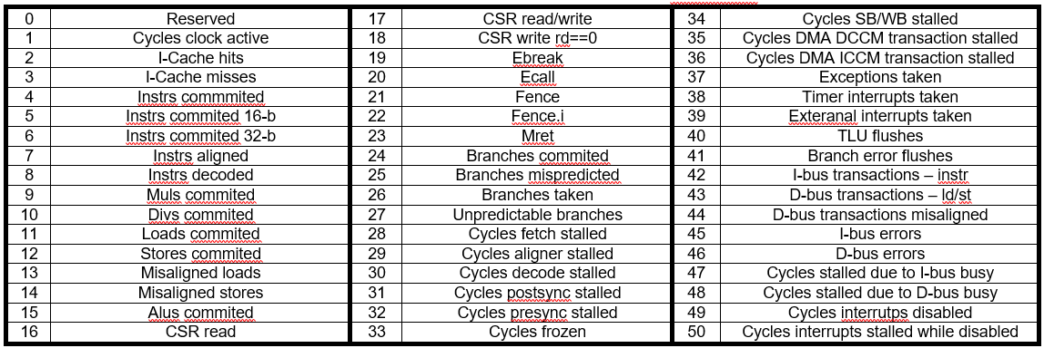
RVfpga Lab 11: Hardware Counters
Hardware counters are a set of special-purpose registers included in most current processors to record the metrics shown in the table.

Slide 151
RVfpga Lab 11: Use of the Performance Counters by means of Western Digital’s PSP
#if defined(D_NEXYS_A7)
#include <bsp_printf.h>
#include <bsp_mem_map.h>
#include <bsp_version.h>
#else
PRE_COMPILED_MSG("no platform was defined")
#endif
#include <psp_api.h>
extern void Test_Assembly(void);
int main(void)
{
int cyc_beg, cyc_end;
int instr_beg, instr_end;
int BrCom_beg, BrCom_end;
int BrMis_beg, BrMis_end;
/* Initialize Uart */
uartInit();
pspEnableAllPerformanceMonitor(1);
pspPerformanceCounterSet(D_PSP_COUNTER0, E_CYCLES_CLOCKS_ACTIVE);
pspPerformanceCounterSet(D_PSP_COUNTER1, E_INSTR_COMMITTED_ALL);
pspPerformanceCounterSet(D_PSP_COUNTER2, E_BRANCHES_COMMITTED);
pspPerformanceCounterSet(D_PSP_COUNTER3, E_BRANCHES_MISPREDICTED);
cyc_beg = pspPerformanceCounterGet(D_PSP_COUNTER0);
instr_beg = pspPerformanceCounterGet(D_PSP_COUNTER1);
BrCom_beg = pspPerformanceCounterGet(D_PSP_COUNTER2);
BrMis_beg = pspPerformanceCounterGet(D_PSP_COUNTER3);
Test_Assembly();
cyc_end = pspPerformanceCounterGet(D_PSP_COUNTER0);
instr_end = pspPerformanceCounterGet(D_PSP_COUNTER1);
BrCom_end = pspPerformanceCounterGet(D_PSP_COUNTER2);
BrMis_end = pspPerformanceCounterGet(D_PSP_COUNTER3);
printfNexys("Cycles = %d", cyc_end-cyc_beg);
printfNexys("Instructions = %d", instr_end-instr_beg);
printfNexys("BrCom = %d", BrCom_end-BrCom_beg);
printfNexys("BrMis = %d", BrMis_end-BrMis_beg);
while(1);
}

Slide 152
RVfpga Lab 11: Tasks - Sample
TASK. The Register File is implemented in module dec_gpr_ctl and it is instantiated in module dec. Analyse both the Verilog code and the simulation of the main signals of module dec_gpr_ctl in order to understand how it works.
TASK. Execute the program from Figure 13 on the Nexys A7 board as explained in the GSG. Measure other events in the Hardware Counters for this program.

Slide 153
Lab 12: Arithmetic/Logic Instructions: The add Instruction

Slide 154
RVfpga Lab 12: Introduction
This lab analyses the flow of arithmetic and logical instructions through the SweRV EH1 pipeline, focusing on the add instruction.
Two sections:
Basic analysis of an add instruction
Advanced analysis of an add instruction
The two analyses use the same example program, shown on the next slide.

Slide 155
RVfpga Lab 12: Example program
.globl main
main:
li t3, 0x4 # t3 = 4
li t4, 0x1 # t4 = 1
REPEAT:
INSERT_NOPS_10
add t3, t3, t4 # t3 = t3 + t4
INSERT_NOPS_10
beq zero, zero, REPEAT # Repeat the loop
.end

Slide 156
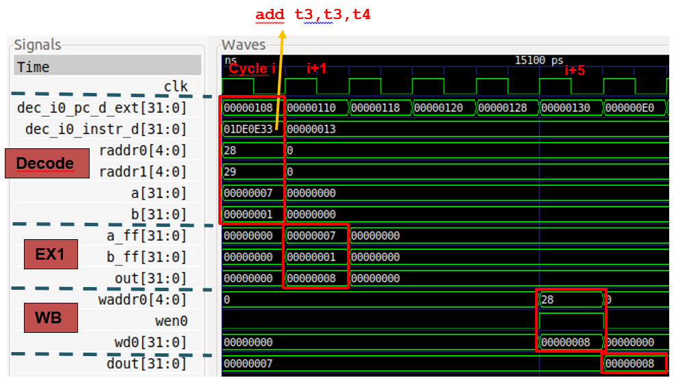
RVfpga Lab 12: Basic Analysis – Simulation

Slide 157
RVfpga Lab 12: Basic Analysis – SweRV EH1 pipeline

Slide 158
RVfpga Lab 12: Basic Analysis – Simulation
Cycle i: Decode: Signal dec_i0_instr_d contains the 32-bit machine instruction 0x01DE0E33. In RISC-V, the fields for the add instruction are: 00 | rs1 | 000 | rd | 0110011
During this stage, control signals are generated and the Register File is read. Moreover, the operands are propagated to the I0 Pipe.
Cycle i+1: EX1: The add instruction is executed. The result of the addition is provided as an output of the ALU in signal out = 8.
Cycle i+5: Writeback: The result of the addition is written back to the Register File: wd0 = 0x8, wen0 = 1 and waddr0 = 0x28

Slide 159
RVfpga Lab 12: Advanced Analysis
Figure on next page shows a detailed diagram of add instruction traversing the I0 pipe.

Slide 160
Detailed diagram of add traversing the I0 pipe

Slide 161
RVfpga Lab 12: Tasks and Exercises - Sample
TASK. In the example from Figure 2, replace the add instruction with a non A-L instruction (such as a mul instruction). Verify that the i0_ap signal has all its fields equal to 0 and that this makes the I0 ALU not work.
TASK. Perform a simulation of a sub instruction similar to the one from Figure 7.
TASK. Analyse the Verilog implementation of the adder/subtractor implemented in module exu_alu_ctl.
TASK. In the Verilog code, analyse how signals wen0 and waddr0 are generated in the Decode stage and propagated to the Writeback stage.
Exercises 1, 3, 4, 5. Perform a similar analysis to the one presented in this lab for other instructions such as: and, or, xor , srl, sra, sll, slt, sltu, addi, andi, ori, xori, srli, srai, slli, slti, and sltui.
Exercises 2, 6, 7. Exercises based on different exercises the two main reference books:
“Computer Organization and Design – RISC-V Edition”, by Patterson & Hennessy.
“Digital Design and Computer Architecture: RISC-V Edition” by S. Harris and D. Harris.

Slide 162
Lab 13: Memory Instructions: lw and sw Instructions

Slide 163
RVfpga Lab 13: Introduction
Lab 13 analyses memory reads and writes.
Three parts:
Low-latency Loads: Examine Load/Store pipe when reading low-latency DCCM (does not stall the processor).
Low-latency Stores: Examine stores to the DCCM.
High-latency loads and stores: Repeat previous analyses when reading/writing the DDR main memory available on the Nexys A7 board.

Slide 164
RVfpga Lab 13: Loads – Example Program
.globl main
.section .midccm
A: .space 8
.text
main:
# Register t3 = x28 (register 28)
la t0, A # t0 = addr(A)
li t1, 0x2 # t1 = 2
sw t1, (t0) # A[0] = 2
add t1, t1, 6 # t1 = 8
sw t1, 4(t0) # A[1] = 8
INSERT_NOPS_9
REPEAT:
INSERT_NOPS_1
lw t1, (t0)
INSERT_NOPS_9
INSERT_NOPS_4
lw t1, 4(t0)
INSERT_NOPS_10
INSERT_NOPS_4
beq zero, zero, REPEAT # Repeat the loop
.end

Slide 165
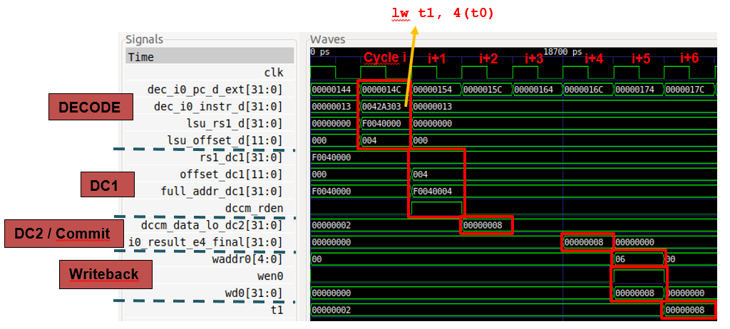
RVfpga Lab 13: Low-latency loads – Simulation

Slide 166
RVfpga Lab 13: Low-latency Loads – SweRV EH1 pipeline

Slide 167
RVfpga Lab 13: Low-latency Loads – Analysis
Cycle i: Decode: generates control signals and reads operands:
t0 = 0xF0040000
Offset = 0x004
Cycle i+1: DC1:
Computes address: full_addr_dc1 = 0xF0040004
Finds memory region of the access → dccm_rden asserts
Cycle i+2: DC2: the DCCM is read → dccm_data_lo_dc2 = 0x8
Cycle i+5: Writeback: The value read from memory is written back to the register file:
wd0 = 0x8
wen0 = 1
waddr0 = 0x6

Slide 168
RVfpga Lab 13: Detailed low-latency Load Analysis
The figure in the next slide shows a detailed diagram of the main elements that a lw instruction traverses during its execution through the I0 Pipe.
This was already illustrated in Lab 11, but the new figure focuses only on the LSU Pipe and provides details related to the lw instruction.
The document for Lab 13 provides deep explanations, not included here, about each stage shown in the figure for the execution of the lw instruction.

Slide 169
Detailed diagram of lw traversing the I0 pipe

Slide 170
RVfpga Lab 13: Stores – Example program
.globl main
.section .midccm
A: .space 4000
.text
main:
la t0, A # t0 = addr(A)
li t1, 0x2 # t1 = 2
li t2, 1000 # t2 = 1000
INSERT_NOPS_2
REPEAT:
sw t1, (t0)
INSERT_NOPS_10
INSERT_NOPS_4
lw t1, (t0)
INSERT_NOPS_10
add t1,t1,t1
add t0,t0,0x04
add t2,t2,-1
INSERT_NOPS_10
bne t2, zero, REPEAT # Repeat the loop
nop
nop
.end

Slide 171
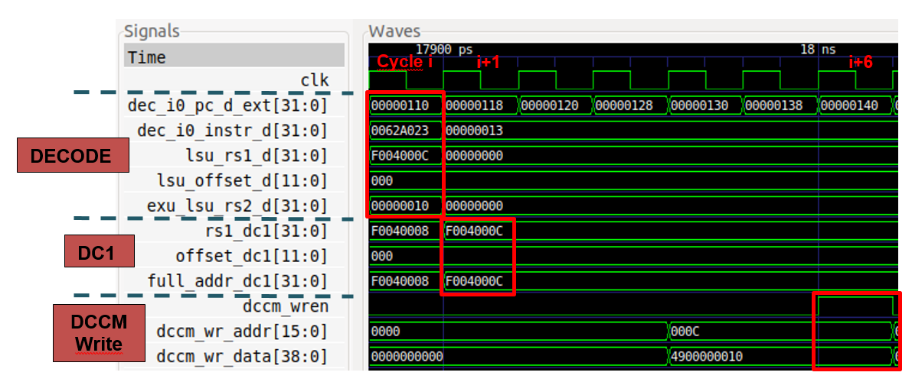
RVfpga Lab 13: Low-latency Store – Simulation

Slide 172
RVfpga Lab 13: Low-latency Store – SweRV EH1 pipeline

Slide 173
RVfpga Lab 13: Store basic analysis – Simulation
Cycle i: Decode: generates control signals and reads operands:
t0 = 0xF004000C
Offset = 0x000
t1 = 0x10
Cycle i+1: DC1:
Computes address: full_addr_dc1 = 0xF004000C
Cycle i+6: DCCM write:
dccm_wr_addr = 0x000C
dccm_wr_data = 0x4900000010

Slide 174
RVfpga Lab 13: Load to the External Memory
The figure on the next slide shows the main path the lw instruction traverses to read Main Memory.
The processor must stall waiting for data from the External Memory.
The External Memory is accessed through the AXI bus, which provides the address to the Lite DRAM controller and, some cycles later, aligns and sends the requested data to the DC3 stage.
A 2:1 multiplexer in the DC3 stage selects the data coming from the External Memory, instead of the data coming from the DCCM.

Slide 176
RVfpga Lab 13: External Memory – Example program
.globl main
.data
D: .word 3,5,6,8,7,10,12,2,1,4,11,9
.text
main:
li t2, 0x020
csrrs t1, 0x7F9, t2
la t4, D
li t5, 12
li t6, 0x0
INSERT_NOPS_1
REPEAT:
lw t3, (t4)
add t5, t5, -1
INSERT_NOPS_10
add t6, t3, t6
add t4, t4, 4
INSERT_NOPS_9
bne t5, zero, REPEAT # Repeat the loop
INSERT_NOPS_4
.end

Slide 177
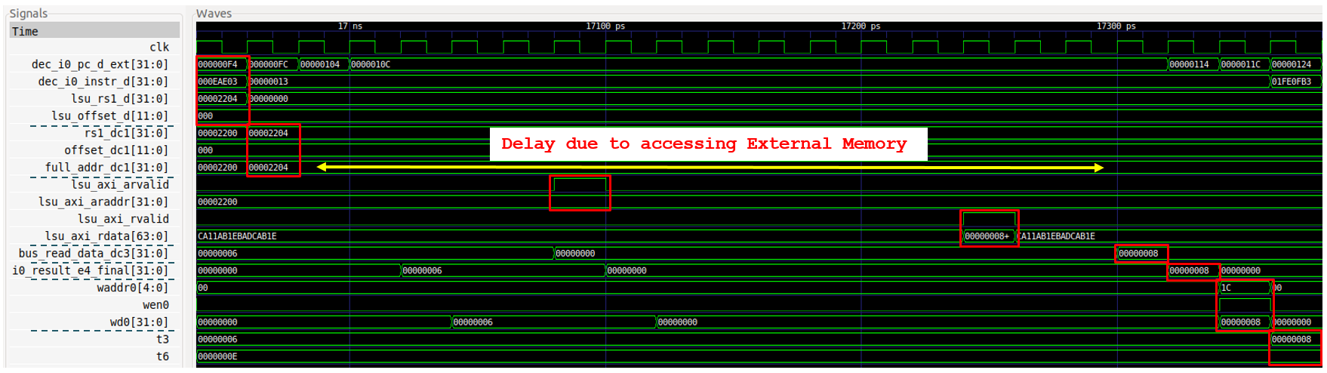
RVfpga Lab 13: External Memory – Simulation

Slide 178
RVfpga Lab 13: External Memory – Analysis
The Decode stage computes the address, which in the fourth iteration of the example is 0x00002204.
Then, the address is sent to the external memory through the AXI bus:
lsu_axi_arvalid = 1
lsu_axi_araddr = 0x00002200
Some cycles later, the external memory returns 64-bit data read through the AXI Bus
lsu_axi_rdata = 0x0000000800000006
lsu_axi_rvalid = 1
Finally, the requested 32-bit data is extracted from the 64-bit data, inserted in the main pipeline path, and written into the Register File.

Slide 179
RVfpga Lab 13: Tasks - Sample
TASK. Include signal lsu_p in the simulation from Figure 4 and analyse its bits.
TASK. Analyse in the Verilog code the path followed by the two inputs to the LSU (exu_lsu_rs1_d and dec_lsu_offset_d) from the sources where they are obtained. Several modules are involved in this process: dec, exu, lsu.
TASK. Analyse the implementation of the two adders from the DC1 stage, which are instantiated in module lsu_lsc_ctl.
TASK. In the program from Figure 2, try different access sizes (byte, half-word) and unaligned accesses. To do so, change the offset or the access type from lw to lb (load byte) or lh (load half-word). For example, if you change the offset from 4 to 3, the load word instruction performs an unaligned access to the 32-bits starting at address 0xF0040003, as shown in Figure 8. Analyse the value of signals lsu_addr_dc1[31:0] (or full_addr_dc1[31:0]) and end_addr_dc1[31:0] under these different situations.
TASK. Analyse unaligned stores to the DCCM, as well as sub-word stores: store byte (sb) or store half-word (sh).
TASK. It can also be interesting to analyse the AXI Bus implementation for accessing the DRAM Controller, for which you can inspect the lsu_bus_intf module.

Slide 180
Lab 14: Structural Hazards

Slide 181
RVfpga Lab 14: Introduction
Lab 14 illustrates two structural hazards (which have different performance-cost trade-offs).
Unit conflict: two mul instructions arrive at the Decode stage in the same cycle. The multiplier is pipelined, so the second mul instruction is only delayed by one cycle. Hardware cost and performance degradation (only one cycle) are low.
Register File write port conflict: Three instructions arrive at the Writeback stage in the same cycle, one of them being a non-blocking load executed several cycles earlier. SweRV EH1 has three (instead of two) write ports. The structural hazard is avoided (resulting in no performance loss), but it has high hardware cost due to the extra register file port.
Note that the div instruction can also cause hazards, which is discussed in the lab’s Appendix.

Slide 182
RVfpga Lab 14: 2 mul Instructions – Example Program
.globl Test_Assembly
Test_Assembly:
li t2, 0xFFFF
li t3, 0x3
li t4, 0x2
li t5, 0x2
li t6, 0x2
REPEAT:
beq t2, zero, OUT # Stay in the loop?
INSERT_NOPS_9
mul t0, t3, t4 # t0 = t3 * t4
mul t1, t5, t6 # t1 = t5 * t6
INSERT_NOPS_9
add t2, t2, -1
add t0, zero, zero
add t1, zero, zero
j REPEAT
OUT:
.end

Slide 183
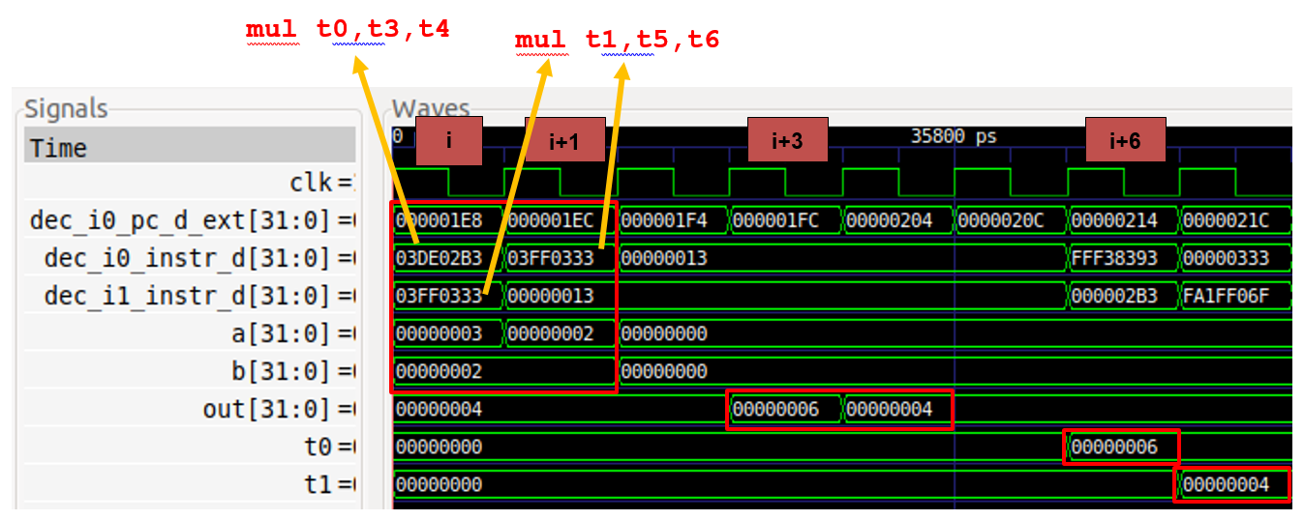
RVfpga Lab 14: 2 mul Instructions – Simulation

Slide 184
RVfpga Lab 14: 2 mul instructions – Analysis
Cycle i: The two mul instructions arrive at the Decode stage in the same cycle. A Structural Hazard prevents the second mul instruction from advancing.
Cycle i+1: The first mul instruction executes in the first stage of the pipelined multiplier (M1), while the second mul instruction waits in the Decode stage.
Cycle i+2: The first mul instruction executes in the second stage of the pipelined multiplier (M2) and the second mul executes in the first stage (M1).
Cycle i+3: The first mul instruction obtains the result: out = 0x6.
Cycle i+4: The second mul instruction obtains the result: out = 0x4.
Cycle i+6: The register file is updated with the result of the first mul (t0 = 0x6).
Cycle i+7: The register file is updated with the result of the second mul (t1 = 0x4).

Slide 185
RVfpga Lab 14: 2 mul Instructions – Diagram

Slide 186
RVfpga Lab 14: 3 Simultaneous Writes – Example Program
REPEAT:
lw x28, (x29)
add x30, x30, -1
add x1, x1, 1
add x31, x31, 1
add x3, x3, 1
add x4, x4, 1
add x5, x5, 1
add x6, x6, 1
add x7, x7, 1
add x8, x8, 1
add x9, x9, 1
add x10, x10, 1
add x11, x11, 1
add x12, x12, 1
add x13, x13, 1
add x14, x14, 1
add x15, x15, 1
add x16, x16, 1
add x17, x17, 1
add x18, x18, 1
add x19, x19, 1
add x20, x20, 1
add x21, x21, 1
add x22, x22, 1
add x23, x23, 1
add x24, x24, 1
add x25, x25, 1
add x26, x26, 1
add x27, x27, 1
add x31, x31, 1
add x3, x3, 1
add x4, x4, 1
add x5, x5, 1
add x6, x6, 1
add x25, x25, 1
add x26, x26, 1
add x27, x27, 1
bne x30, zero, REPEAT

Slide 187
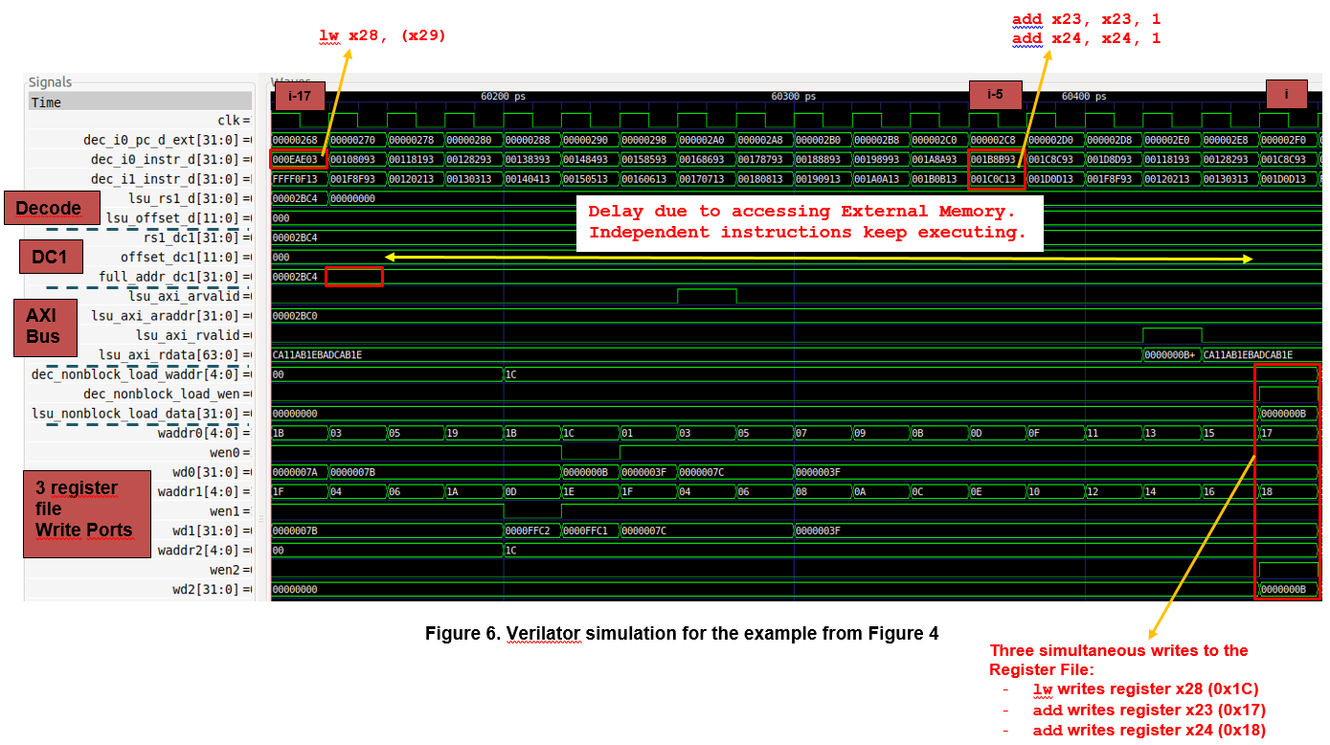

Slide 188
RVfpga Lab 14: 3 Simultaneous Writes – Analysis
Cycle i-17: The lw instruction is at the Decode stage.
Cycle i-16: The effective memory address is computed and sent to the External Memory through the AXI Bus. The load instruction waits several cycles for the External Memory to supply the data.
Cycle i-5: The two conflicting add instructions are decoded.
Cycle i: The lw instruction and the two conflicting add instructions proceed to the Writeback stage, where they write the register file, which is possible because the Register File has three write ports.

Slide 189
RVfpga Lab 14: 3 Simultaneous Writes – Diagram

Slide 190
RVfpga Lab 14: Tasks and Exercises - Sample
TASK: Inspect the Verilog code from exu_mul_ctl and see how the multiplication is computed. Remember that RISC-V includes 4 multiply instructions (mul, mulh, mulhsu and mulhu), and all of them must be supported by the hardware.
TASK: Remove the nop instructions included within the loop from Figure 1 and measure different events (cycles, instructions/multiplies committed, etc.) using the Performance Counters available in SweRV EH1, as explained in Lab 11. Is the number of cycles as expected after analysing the simulation from Figure 2? Justify your answer. Now reorder the code within the loop trying to reach the ideal throughput. Justify the results obtained in the original code and in the reordered one.
TASK: Modify the program from Figure 1, replacing the two mul instructions for two lw instructions to the DCCM. You should observe a structural hazard analogous to the one analysed in this section and resolved in a similar way.
TASK: Compare the simulation shown in Figure 6 (non-blocking load) with the simulation shown in Figure 14 of Lab 13 (blocking load).
Exercise 1. Analyse, both in simulation and on the board, the structural hazard that happens between two consecutive memory instructions (you can analyse any combination of two consecutive memory instructions such as loads and stores) that arrive at the L/S Pipe in the same cycle.
Exercise 2. This following exercise is based on exercise 4.22 from the book “Computer Organization and Design – RISC-V Edition”, by Patterson & Hennessy ([PaHe]).

Slide 191
Lab 15: Data Hazards

Slide 192
RVfpga Lab 15: Introduction
Lab 15 analyses how RAW data hazards are resolved.
RAW data hazards are resolved by stalling the processor or forwarding (also called bypassing) the value from an instruction executing in a later stage.
Two scenarios analysed:
RAW data hazards resolved by forwarding to the Decode stage (using several new multiplexers)
RAW data hazards resolved in the Commit stage using two additional ALUs

Slide 193
RVfpga Lab 15: Solving Data Hazards by Forwarding
Forwarding to the Decode stage requires adding multiplexers in front of the Functional Units (ALUs, Multiplier, Adder that computes the Effective Address in DC1, etc.) to select operands from either the Register File or from subsequent stages.
The figure on the next slide shows the forwarded values in the Decode stage. The Forwarding Logic produces bypass signals for each of the two source operands in each of the Ways

Slide 195
RVfpga Lab 15: Solving Data hazards by Forwarding – Example
.globl Test_Assembly
.text
Test_Assembly:
li t3, 0x3
li t4, 0x2
li t5, 0x1
li t6, 0xFFFF
REPEAT:
INSERT_NOPS_8
add t4, t4, t5 # t4 = t4 + t5 (t4 = 2 + 1)
add t6, t6, -1
add t3, t3, t4 # t3 = t3 + t4 (t3 = 3 + 3)
INSERT_NOPS_9
li t3, 0x3
li t4, 0x2
li t5, 0x1
bne t6, zero, REPEAT # Repeat the loop
00000180 <REPEAT>:
180: 01ee8eb3 add t4,t4,t5
184: ffff8f93 addi t6,t6,-1
188: 01de0e33 add t3,t3,t4
18c: 00300e13 li t3,3
190: 00200e93 li t4,2
194: 00100f13 li t5,1
198: fe0f94e3 bnez t6,180 <REPEAT>

Slide 196
RVfpga Lab 15: Solving Data Hazards by Forwarding – Diagram

Slide 197
RVfpga Lab 15: Solving Data Hazards by Forwarding – Pipeline – Cycle i

Slide 198
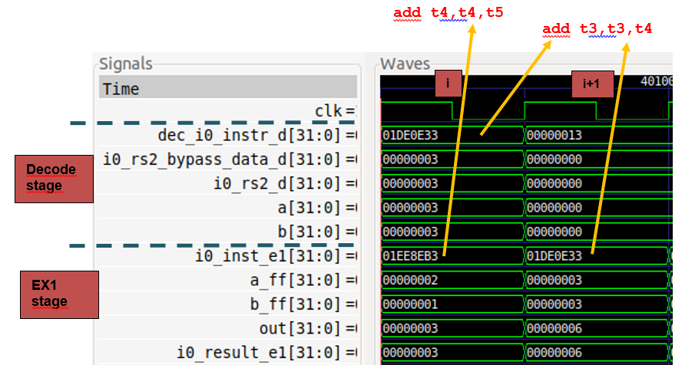
RVfpga Lab 15: Solving Data Hazards by Forwarding – Simulation

Slide 199
RVfpga Lab 15: Solving Data Hazards by Forwarding – Analysis
Instruction add t4,t4,t5 (0x01ee8eb3):
Cycle i: This add instruction is in the EX1 stage of the I0 Pipe (i0_inst_e1 = 0x01ee8eb3). It computes the following addition in the ALU:
a_ff (2) + b_ff (1) = out (3)
The result is sent to the Forwarding Logic in the Decode stage.
Instruction add t3,t3,t4 (0x01de0e33):
Cycle i: This add instruction is in the Decode stage of Way-0 (dec_i0_instr_d = 0x01de0e33). The Forwarding Logic forwards the result from EX1 (i0_result_e1) to the Decode stage (i0_rs2_bypass_data_d). Two 3:1 multiplexers produce the operands, specifically:
Operand a = 3 (from the Register File)
Operand b = 3 (from the ALU output in the EX1 stage of the I0 Pipe, through the Forwarding Logic)
Cycle i+1: This add instruction is in the EX1 stage of the I0 Pipe (i0_inst_e1 = 0x01de0e33). It computes the correct addition in the ALU:
a_ff (3) + b_ff (3) = out (6)

Slide 200
Detailed diagram of forwarding logic

Slide 201
RVfpga Lab 15: Solving Data Hazards by Forwarding at Commit
Instructions that need several cycles to obtain the result (i.e. a multi-cycle operation, such as a lw, mul, and div) cannot forward to Decode stage.
But SweRV EH1 adds an extra ALU (the Secondary ALU) in the Commit stage of each way. This ALU recalculates the arithmetic-logic operation with the proper inputs when necessary.
Thus, no cycles are lost due to stalling – but the cost is two extra ALUs (one per way) as well as added control signals and logic.

Slide 202
RVfpga Lab 15: Solving Data Hazards by Forwarding at Commit – Pipeline

Slide 203
RVfpga Lab 15: Solving Data Hazards by Forwarding at Commit – Example
.globl Test_Assembly
.section .midccm
A: .space 4
.text
Test_Assembly:
la t0, A # t0 = addr(A)
li t1, 0x1 # t1 = 1
sw t1, (t0) # A[0] = 1
li t1, 0x0 li t3, 0x1 li t6, 0xFFFF
REPEAT:
beq t6, zero, OUT # Stay in the loop?
INSERT_NOPS_9
lw t1, (t0)
add t6, t6, -1
add t3, t3, t1 # t3 = t3 + t1
INSERT_NOPS_8
li t1, 0x0
li t3, 0x1
add t4, t4, 0x1
add t5, t5, 0x1
j REPEAT
OUT:
.end

Slide 204
RVfpga Lab 15: Solving Data Hazards by Forwarding at Commit – Pipeline

Slide 205
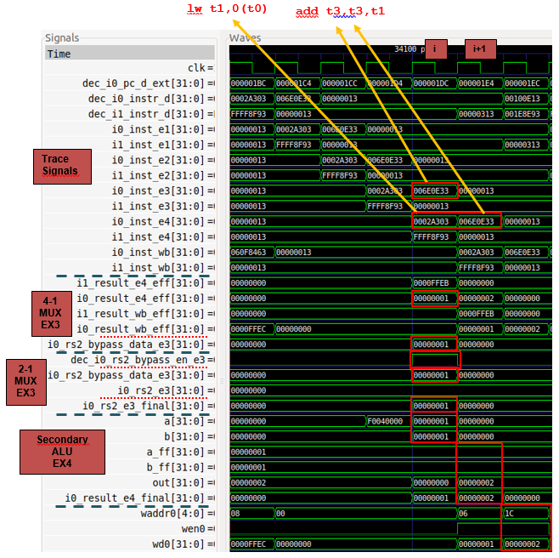
RVfpga Lab 15: Solving Data Hazards by Forwarding at Commit – Simulation

Slide 206
RVfpga Lab 15: Solving Data Hazards by Forwarding at Commit – Simulation
Trace Signals
Cycle i: the add instruction is in the EX3 stage of Way 0 (i0_inst_e3 = 0x006E0E33), and the lw instruction is in the Commit stage of the I0 Pipe (i0_inst_e4 = 0x0002A303).
Cycle i+1: the add instruction is in the Commit stage of Way 0 (i0_inst_e4 = 0x006E0E33).
4:1 Multiplexer
Cycle i: the result from the lw instruction (in the Commit stage), is selected:
i0_rs2_bypass_data_e3 = i0_result_e4_eff = 0x00000001
2:1 Multiplexer
Cycle i: the bypass value is selected due to the dependency between the lw and the add:
i0_rs2_e3_final = i0_rs2_bypass_data_e3 = 0x00000001
Commit stage ALU
Cycle i+1: the add operation is recomputed using the correct values:
out = a_ff + b_ff = 0x00000001 + 0x00000001 = 0x00000002
3:1 multiplexer
Cycle i+1: The Secondary ALU’s output is selected (exu_i0_result_e4). (When no dependency exists, i0_result_e4 is selected.)

Slide 207
RVfpga Lab 15: Tasks – Sample
TASK: Remove all nop instructions in the example from Figure 2. Draw a figure similar to Figure 3 for two consecutive iterations of the loop, then analyse and confirm that the figure is correct by comparing it to a Verilator simulation, and finally compute the IPC by using the Performance Counters while executing the program on the board.
TASK: In the example from Figure 2, remove all nop instructions and move the add t6,t6,-1 instruction after the add t3,t3,t4 instruction, and then re-examine the program both in simulation and on the board. In this reordered program, the two dependent add instructions (add t4,t4,t5 and add t3,t3,t4) arrive at the Decode stage in the same cycle, and this has an impact in performance. Explain the impact of these changes, using both simulation and execution on the board.
TASK: Compare the equations for the 10:1 multiplexer in the Forwarding Logic with the ones explained for the pipelined processor from DDCARV.
TASK: Remove the nop instructions in the example from Figure 11 and obtain the IPC using the HW Counters.
TASK: Disable the Secondary ALU as explained in Lab 11 and analyse the example from Figure 11 both with a Verilator simulation and with an execution on the board.

Slide 208
RVfpga Lab 15: Exercises – Sample
Exercise 1. Modify the program used in Section 3 by adding an extra arithmetic-logic instruction that depends on the result of the add instruction. Analyse the Verilator simulation and explain how data hazards are handled for the new A-L instruction. Then remove all nop instructions and analyse the results provided by the HW counters.
Exercise 2. Analyse the same situation as the one described in Section 3 for a mul instruction followed by an add instruction that uses the result of the multiplication. In the program from Figure 11 you can simply substitute the lw for a mul that writes to register t1.
Exercise 5. In the program from Section 2.C of Lab 14, replace instruction add x1, x1, 1 with add x28, x1, 1. This introduces a WAW hazard between the modified add instruction and the non-blocking load at the beginning of the loop (lw x28, (x29)). Analyse in simulation how this hazard is handled in SweRV EH1, for which you can look at the value of signal wen2 in the Register File. Try to understand how this signal is computed in the Control Unit (module dec).
Exercise 7. In the program from Section 2.C of Lab 14, replace instruction add x1, x1, 1 with add x1, x28, 1, and instruction add x7, x7, 1 with add x28, x7, 1. This causes both a RAW and a WAW hazard to occur. Analyse in simulation how these two hazards are handled.
Exercise 8 - Store to Load Forwarding: This is a very interesting situation that we have not analysed in this lab and that you will analyse in this exercise.

Slide 209
Lab 16: Control Hazards and Branch Instructions

Slide 210
RVfpga Lab 16: Control Hazards & Branches
Branch instructions calculate the address of the next instruction after its fetch.
Control hazards may:
Stall the pipeline until next instruction address is calculated, or
Predict whether the branch will be taken and fetch instructions from the predicted path.
SweRV EH1 has two possible branch predictors (BPs) :
Naïve Branch Predictor: always predicts branch not taken. Has poor performance but at no hardware cost.
Gshare Branch Predictor: offers higher performance at the cost of extra hardware.
This lab analyzes the execution of a beq instruction using both the naïve and Gshare BP.

Slide 211
RVfpga Lab 16: Execution of a beq Instruction and PC Calculation

Slide 212
RVfpga Lab 16: Execution of a beq Instruction and PC Calculation – Example
Test_Assembly:
li t2, 0x008 # Disable Branch Predictor
csrrs t1, 0x7F9, t2
li t3, 0xFFFF
li t4, 0x1
li t5, 0x0
li t6, 0x0
LOOP:
add t5, t5, 1
INSERT_NOPS_7
beq t3, t4, OUT
INSERT_NOPS_7
add t4, t4, 1
INSERT_NOPS_7
beq t3, t3, LOOP
INSERT_NOPS_7
OUT:
INSERT_NOPS_8
.end

Slide 213
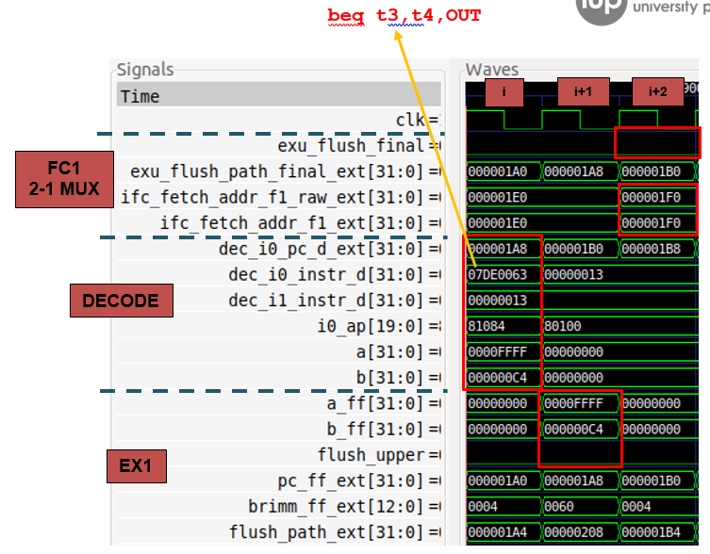
RVfpga Lab 16: Execution of First beq Instruction – Simulation

Slide 214
RVfpga Lab 16: Execution of First beq Instruction – Analysis
Cycle i - Decode stage for the beq instruction: The first beq (0x07DE0063) is decoded in Way 0. Control signals are generated, the Register File is read, and the branch instruction is routed to the I0 Pipe. Signals a and b (0xFFFF and 0xC4, respectively, in this example) contain the inputs to the comparator used in the next stage.
Cycle i+1 - EX1 stage for the beq instruction: The beq instruction is executed. Signals a_ff and b_ff are compared. The two numbers (0xFFFF and 0xC4) are different, so the branch is not taken. In this example the Gshare predictor is disabled, thus all branches are predicted not taken (i0_ap.predict_nt = 1). Thus, the branch has been predicted correctly, and the pipeline is not flushed (flush_upper = 0).
Cycle i+2 - FC1 stage: Given that the branch was predicted and resolved as not taken, fetching simply continues sequentially. Notice that exu_flush_final = 0 and ifc_fetch_addr_f1_ext[31:0] = ifc_fetch_addr_f1_raw_ext[31:0] = 0x000001F0. This address points to the next sequential 128-bit bundle of instructions.

Slide 215
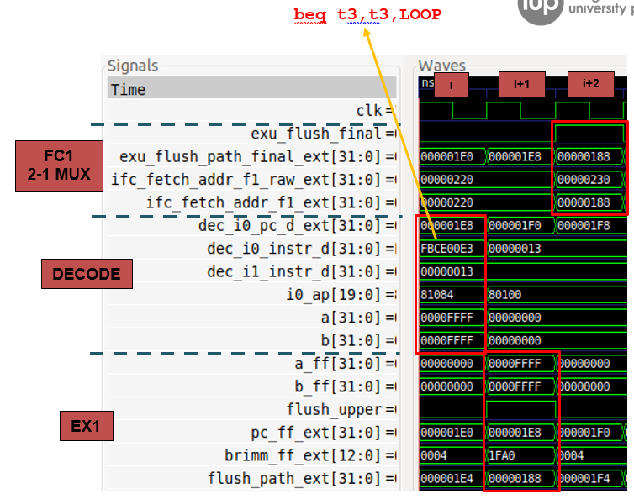
RVfpga Lab 16: Execution of Second beq Instruction – Simulation

Slide 216
RVfpga Lab 16: Execution of Second beq Instruction – Analysis
Cycle i - Decode stage for the beq instruction: The second beq (0xFBCE00E3) is decoded in Way 0. Pipeline control signals are generated, the Register File is read, and the branch instruction is routed to the I0 Pipe. Signals a and b (0xFFFF for both of them, in this example) contain the inputs to the comparator used in the next stage.
Cycle i+1 - EX1 stage for the beq instruction: The beq instruction is executed. Signals a_ff and b_ff are compared. The two numbers are equal, so the branch is taken. However, the Naïve BP predicts all branches as not taken (i0_ap.predict_nt = 1). So, the branch has been mispredicted, and the fetched instructions must be flushed (flush_upper = 1)..
Cycle i+2 - FC1 stage: Execution must continue at the branch target address. exu_flush_final = 1 and ifc_fetch_addr_f1_ext = exu_flush_path_final_ext = 0x00000188. This address corresponds to the branch target address, which is the address of the first instruction of the loop.

Slide 217
RVfpga Lab 16: The Gshare Branch Predictor used by SweRV EH1

Slide 218
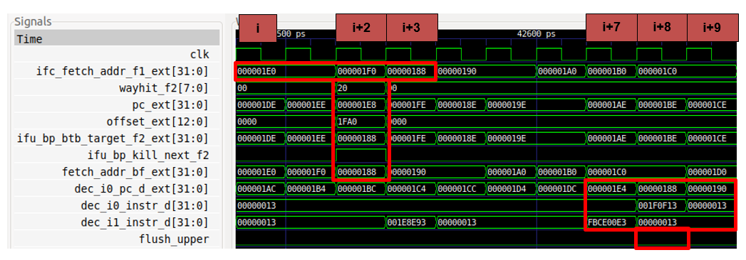
RVfpga Lab 16: The Gshare Branch Predictor for the Second beq

Slide 219
RVfpga Lab 16: The Gshare Branch Predictor for the second beq
Cycle i: The address of the bundle that contains the second branch is provided to the Instruction Cache: ifc_fetch_addr_f1_ext = 0x000001E0. The Branch Target Buffer (BTB) is read using this address.
Cycle i+2: A hit takes place in the BTB: wayhit_f2 = 0x20. The address of the branch (pc_ext = 0x000001E8) is added to the offset provided by the BTB (offset_ext = 0x1FA0, which is a negative value), which results in the predicted target address (ifu_bp_btb_target_f2_ext = 0x00000188). Given that the branch is predicted taken by the BHT (ifu_bp_kill_next_f2 = 1), it is used as the Next Fetch PC (fetch_addr_bf_ext = 0x00000188).
Cycle i+3: The Fetch Address is the predicted target address of the branch, which was computed in the previous cycle: ifc_fetch_addr_f1_ext = 0x00000188.
Cycle i+7: The branch is decoded in Way 1 (dec_i1_instr_d = 0xFBCE00E3).
Cycle i+8: The branch executes. The prediction was correct, so no flush needs to be triggered (flush_upper = 0).
Cycle i+9: Execution continues normally through the branch target address given that the prediction was correct.

Slide 220
RVfpga Lab 16: Tasks and Exercises - Sample
TASK: In Lab 15, we analysed how RAW data hazards are resolved in the Commit stage by means of the Secondary ALUs. Similar to the A-L instructions that we studied in that lab, a conditional branch instruction can have a RAW data hazard with a previous multi-cycle operation that must be resolved at commit time. If the branch is determined to have been mispredicted, the pipeline must be flushed and redirected from the Commit stage. Analyse this situation using a slightly modified version of the program from Figure 2.
TASK: In the example from Figure 2, remove all the nop instructions and analyse the simulation. Then compute the IPC with the Performance Counters by executing the program on the board. Enable the branch predictor used in SweRV EH1 (by commenting out the two initial instructions in Figure 2) and analyse the simulation and the execution on the board. Compare the two experiments and explain the results.
TASK: Explain how the Global History Register is updated at module ifu_bp_ctl.
Exercise 1) Implement a Bimodal Branch Predictor and compare its performance to the Gshare BP.
Exercise 2) This exercise is based on exercise 4.25 from the book “Computer Organization and Design – RISC-V Edition”, by Patterson & Hennessy ([HePa]).

Slide 221
Lab 17: Superscalar Execution

Slide 222
RVfpga Lab 17: Introduction
Western Digital’s SweRV EH1 processor is a 9-stage pipelined 32-bit 2-way superscalar core.
A superscalar processor contains multiple copies of the datapath hardware to execute multiple instructions simultaneously.
The latency of executing a single instruction is the same as a scalar processor, but the processor can execute and commit more instructions per cycle, thus improving its throughput.
SweRV EH1 does not include support for dynamic instruction scheduling with out-of-order execution, except for the non-blocking loads. However, it is possible to statically reorder the code in order to better exploit the resources, including the two ways of the pipeline.

Slide 223
RVfpga Lab 17: Introduction
SweRV EH1 is a 2-way superscalar processor.
It fetches, executes, and commits up to two instructions per cycle.
The multi-ported register file reads up to four source operands and writes two values back in each cycle (plus one more value coming from a non-blocking load, as analysed in Lab 15).
Each way contains independent pipes: two Integer pipes, one Multiply pipe, one Load-Store pipe, and one non-pipelined Divider.
Ideally, in a 2-way superscalar processor, throughput (IPC) doubles compared to a single-issue processor. Unfortunately, actual programs typically exhibit performance improvements of 1.3x-1.5x when going from 1- to 2-way processors; however, adding the second way requires much more hardware.
In this lab, we analyse two simple programs, comparing the behaviour when using single-issue and dual-issue configurations of SweRV EH1.

Slide 224
RVfpga Lab 17: Four Independent A-L Instructions – Example – Single-Issue
.globl Test_Assembly
.text
Test_Assembly:
li t2, 0x400 # Disable Dual-Issue Execution
csrrs t1, 0x7F9, t2
li t0, 0x0
li t1, 0x1
li t2, 0x1
li t3, 0x3
li t4, 0x4
li t5, 0x5
li t6, 0x6
lui t2, 0xF4
add t2, t2, 0x240
REPEAT:
add t0, t0, 1
INSERT_NOPS_10
INSERT_NOPS_4
add t3, t3, t1
sub t4, t4, t1
or t5, t5, t1
xor t6, t6, t1
INSERT_NOPS_10
INSERT_NOPS_3
bne t0, t2, REPEAT # Repeat the loop

Slide 225
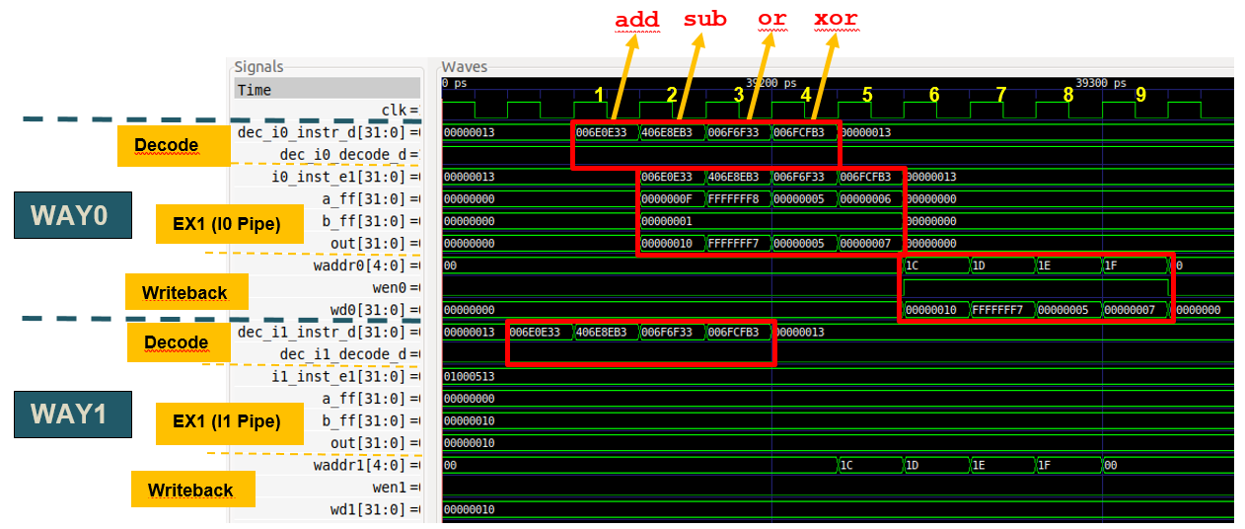
RVfpga Lab 17: Four Independent A-L Instructions – Simulation – Single-Issue

Slide 226
RVfpga Lab 17: Four Independent A-L Instructions – Simulation – Single-Issue
The instructions are received in both ways at decode time, but they are only sent to execution in Way 0, because Way 1 is disabled.
Way 0:
Signal dec_i0_decode_d is always 1 in our example; specifically, it is 1 for the four AL instructions under analysis.
The instruction in the Decode Stage is propagated to the I0 Pipe (i0_inst_e1[31:0])
Way 1:
Signal dec_i1_decode_d is always 0 in our example; specifically, it is 0 for the four AL instructions under analysis.
The instruction at the Decode Stage is NOT propagated (i1_inst_e1[31:0]) to the Execution Stage.
Accordingly, only the ALU from the I0 Pipe is used (see signals aff, bff and out in both ways) and only write port 0 of the Register File is used (see signals waddr, wen and wd in both ways).

Slide 227
RVfpga Lab 17: Four Independent A-L Instructions – Diagram – Single-Issue

Slide 228
RVfpga Lab 17: Four Independent A-L Instructions – Example – Dual-Issue
.globl Test_Assembly
.text
Test_Assembly:
# li t2, 0x400 # Disable Dual-Issue Execution
# csrrs t1, 0x7F9, t2
li t0, 0x0
li t1, 0x1
li t2, 0x1
li t3, 0x3
li t4, 0x4
li t5, 0x5
li t6, 0x6
lui t2, 0xF4
add t2, t2, 0x240
REPEAT:
add t0, t0, 1
INSERT_NOPS_10
INSERT_NOPS_4
add t3, t3, t1
sub t4, t4, t1
or t5, t5, t1
xor t6, t6, t1
INSERT_NOPS_10
INSERT_NOPS_3
bne t0, t2, REPEAT # Repeat the loop

Slide 229
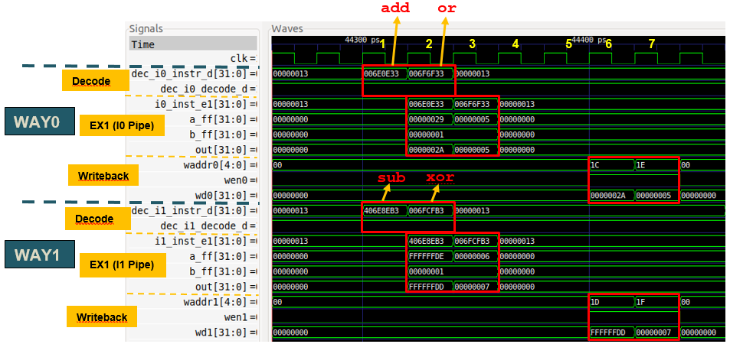
RVfpga Lab 17: Four Independent A-L Instructions – Simulation – Dual-Issue

Slide 230
RVfpga Lab 17: Four Independent A-L Instructions – Analysis – Dual-Issue
In each cycle, two instructions are decoded, one in each way, and two instructions are sent to the Execute stages, one through the I0 pipe and the other through I1.
Way 0:
Signal dec_i0_decode_d is always 1 – being true for two of the four A-L instructions of our example (the other two A-L instructions are decoded in Way 1).
The instruction in the Decode stage is propagated to the I0 Pipe (i0_inst_e1[31:0]).
Way 1:
Signal dec_i1_decode_d is always 1 – being true for two of the four A-L instructions of our example (the other two A-L instructions are decoded in Way 0).
The instruction in the Decode stage is propagated to the I1 Pipe (i1_inst_e1[31:0]).
Thus, the ALUs in both pipes (I0 and I1) are used (see signals aff, bff, and out in both ways), and both Register File write ports are used (see signals waddr, wen and wd in both ways).

Slide 231
RVfpga Lab 17: Four Independent A-L Instructions – Diagram – Dual-Issue

Slide 232
RVfpga Lab 17: Two mul Instructions Interleaved with Two A-L Instructions – Example – Dual-Issue
.globl Test_Assembly
.text
Test_Assembly:
# li t2, 0x400 # Disable Dual-Issue Execution
# csrrs t1, 0x7F9, t2
li t3, 0x3
li t4, 0x4
li t5, 0x5
li t6, 0x6
li t0, 0x0
lui t1, 0xF4
add t1, t1, 0x240
REPEAT:
add t0, t0, 1
INSERT_NOPS_10
INSERT_NOPS_4
mul t3, t3, t1
add t4, t4, t1
mul t5, t5, t1
sub t6, t6, t1
INSERT_NOPS_10
INSERT_NOPS_3
bne t0, t1, REPEAT # Repeat the loop
.end

Slide 233
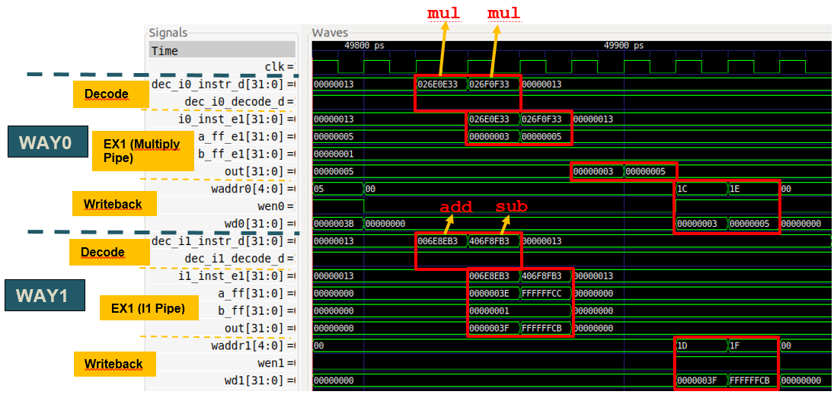
RVfpga Lab 17: Two mul Instructions Interleaved with Two A-L Instructions – Simulation – Dual-Issue

Slide 234
RVfpga Lab 17: Two mul Instructions Interleaved with Two A-L Instructions – Analysis – Dual-Issue
The instructions are received in both ways at decode time and are sent to the execution stages in both ways.
Way 0:
Signal dec_i0_decode_d is always 1 – for two of the four instructions analysed in our example (the other two instructions are decoded in Way 1).
The instruction in the Decode stage is sent to the Multiply pipe (i0_inst_e1[31:0])
Way 1:
Signal dec_i1_decode_d is always 1 – for two of the four instructions analysed in our example (the other two instructions are decoded in Way 1).
The instruction in DECODE (dec_i1_instr_d[31:0]) is propagated to the I1 Pipe (i1_inst_e1[31:0])
Thus, the ALU from the I1 pipe and the Multiplier are used (see signals a_ff_e1, b_ff_e1, and out and signals a_ff, b_ff, and out), and both Register File write ports are used (see signals waddr, wen, and wd in both ways).

Slide 235
RVfpga Lab 17: Tasks and Exercises - Sample
TASK: Remove all the nop instructions within the body of the loop from Figure 2. Repeat the simulation from Figure 3. What is the expected IPC for this program? Execute the program on the board and verify that the IPC obtained is the one that you expected.
Exercise 2) Analyse the differences between the (dual-issue) SweRV EH1 processor and the example superscalar processor proposed in Section 7.7.4 of the textbook by S. Harris and D. Harris, “Digital Design and Computer Architecture: RISC-V Edition” [DDCARV] (shown in Figure 1 for convenience).
Exercise 3) Analyse the program from Figure 7.70 in Section 7.7.4 of DDCARV, which is provided in a PlatformIO project. Run the program on SweRV EH1, both in simulation and on the board (for the latter remove the nop instructions). Explain the results. If necessary, reorder the program trying to obtain the optimal IPC. Next, disable the dual-issue execution as explained in this lab – and in SweRVref.docx (Section 2). Compare the simulation and the results obtained on the board when compared to when the dual-issue feature is enabled.
Exercises 5, 6 and 7) These exercises are based on exercises from the books:
“Computer Organization and Design – RISC-V Edition”, by Patterson & Hennessy.
“Digital Design and Computer Architecture: RISC-V Edition”, by S. Harris and D. Harris.

Slide 236
Lab 18: Adding New Features: Instructions and Counters

Slide 237
RVfpga Lab 18: Adding Instructions & Features
In this lab, you will apply the knowledge acquired in previous labs to modify the SweRV EH1 processor to add the following new features:
Add A-L instructions: Add Arithmetic-Logic instructions from the new bit manipulation extension available in the RISC-V architecture.
Add floating-point instructions: Add three floating point instructions: add, multiply, and divide. Then use them to compute the bisection algorithm.
Add counter: Add a new hardware counter that counts the number of I-Type instructions executed.
In some of these exercises we guide you through the process of modifying the core, and in others you will figure out on your own what needs to be done.

Slide 238
Lab 19: Instruction Cache

Slide 239
RVfpga Lab 19: Introduction
This lab describes and explores the memory system of the RVfpga System. RVfpga’s Memory System has the following elements:
External DDR Main Memory
Cache for instructions (I$)
Two Scratchpad memories (also called closely-coupled memories), one for data (DCCM) and one for instructions (ICCM). The ICCM is disabled in the default system.
In this lab, we first describe how data are read from and written to the DDR External Memory, and then we delve into the operation and management of the I$ available in the RVfpga System.

Slide 240
RVfpga Lab 19: Data read and write to Memory – Example
.data
D: .space 40000
.text
Test_Assembly:
li t2, 0x000
csrrs t1, 0x7F9, t2
la t4, D
li t5, 50
li t0, 40000
la t6, D
add t6, t6, t0
REPEAT:
lw t3, (t4)
add t3, t3, t5
sw t3, (t4)
add t4, t4, 4
bne t4, t6, REPEAT

Slide 241
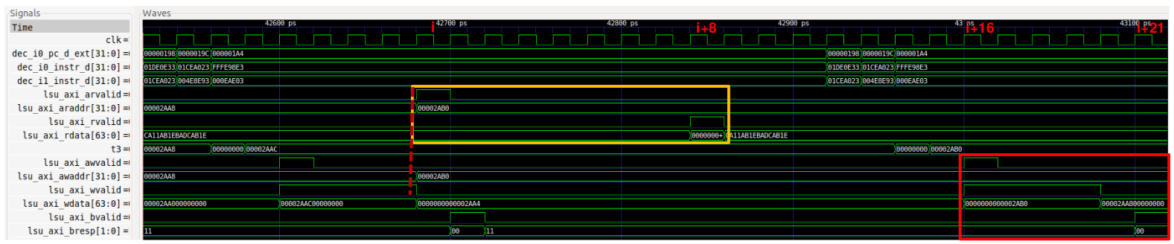
RVfpga Lab 19: Data read and write to Memory – Simulation
The example illustrates a program that includes a load instruction followed by a store instruction
Cycle i – i+8: The processor reads data from the DDR External Memory (yellow square) into t3, through the bus.
Cycle i+16 – i+21: The processor writes the value of t3 to the DDR External Memory (red square), through the bus.

Slide 242
RVfpga Lab 19: I$ Configuration and Operation

Slide 243
RVfpga Lab 19: I$ Miss and Hit Management – Example
Test_Assembly:
INSERT_NOPS_3
INSERT_NOPS_8
INSERT_NOPS_8
li t6, 0x10000
REPEAT:
add t6, t6, -1
add t0, t0, t0
add t1, t1, t1
add t2, t2, t2
add t3, t3, t3
add t4, t4, t4
add t5, t5, t5
add t6, t6, t6
add a7, a7, a7
add t0, t0, t0
add t2, t2, t2
add t1, t1, t1
add t3, t3, t3
add t4, t4, t4
add t6, t6, t6
add t5, t5, t5
add a7, a7, a7
INSERT_NOPS_8
INSERT_NOPS_8
INSERT_NOPS_8
INSERT_NOPS_8
INSERT_NOPS_8
INSERT_NOPS_8
bne t6, zero, REPEAT
ret

Slide 244
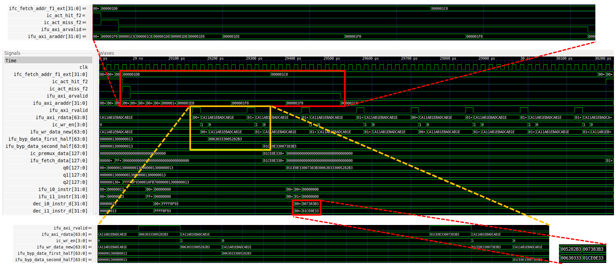
RVfpga Lab 19: I$ Miss Management - Simulation

Slide 245
RVfpga Lab 19: I$ Miss Management - Analysis
The simulation shows the fetch of the 16 add instructions the first time they are executed. Given that these instructions are not in the I$ yet, a miss is triggered in the I$ and the instructions must be copied from the DDR External Memory into the I$.
An I$ miss is signalled at around 29ns (ic_act_miss_f2 = 1), which triggers the request of the block through the AXI bus (ifu_axi_arvalid = 1).
The eight 64-bit chunks that make up the target block are requested sequentially through the AXI bus.
Signal ifu_axi_arvalid goes high for 27 cycles. This signal indicates that the channel is signalling valid read address and control information.
During these 27 cycles where ifu_axi_arvalid = 1 the initial addresses of the eight 64-bit chunks are provided sequentially through the AXI bus using signal ifu_axi_araddr, which provides the 8 addresses that must be read from the DDR Memory.

Slide 246
RVfpga Lab 19: I$ Miss Management - Analysis
The middle figure shows the eight 64-bit chunks arriving sequentially to the processor through the AXI bus in signal ifu_axi_rdata.
Signal ifu_axi_rvalid, which indicates that the channel is signalling the required read data, goes high for one cycle every 7 cycles.
Each of the eight 64-bit chunks (each containing two instructions) is provided in signal ifu_axi_rdata.
The two bottom figures show that each of the eight 64-bit chunks is written into the I$ right after their arrival to the cache controller.
Finally, you can see that the four instructions are bypassed from the I$ controller to the pipeline so that it can restart execution as soon as possible after the I$ miss. Several cycles later, the four instructions arrive at the Decode Stage.

Slide 247
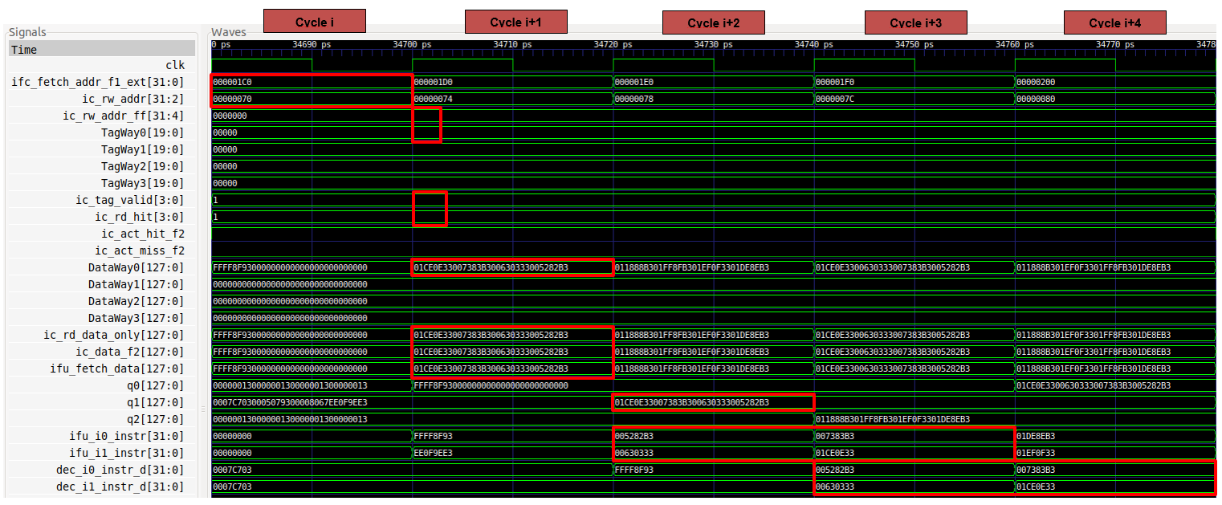
RVfpga Lab 19: I$ Hit Management - Simulation

Slide 248
RVfpga Lab 19: I$ Hit Management - Analysis
In the previous simulation you can see a hit in the I$.
Cycle i: The address of the first add instruction (add t0,t0,t0) is given in signal ifc_fetch_addr_f1_ext. This signal is passed to the I$ except for its two least significant bits, which are not needed because instructions are 4-byte (32-bit) aligned. Thus, ic_rw_addr = 0x0000070. The Tag and Data Arrays use a subset of the Fetch Address.
Cycle i+1: The four tags, one per cache way, are in signals TagWay0-TagWay3. These are compared to the TAG field of the Fetch Address. In this case, all tags are the same as the TAG field, however only one way (Way 0) is valid (ic_tag_valid = 0001), thus a hit is signalled in Way 0: ic_rd_hit = 0001. Also, four 128-bit bundles are in signals DataWay0-DataWay3: ic_rd_data_only = 0x01ce0e33007383b300630333005282b3
Cycle i+2: The first and second add instructions are extracted in the Align stage from buffer q1: ifu_i0_instr = 0x005282b3 and ifu_i1_instr = 0x00630333
Cycle i+3: The third and fourth add instructions are extracted in the Align stage and, at the same time, the first and second add instructions are decoded: ifu_i0_instr = 0x007383b3, ifu_i1_instr = 0x01ce0e33, dec_i0_instr_d = 0x005282b3 and dec_i1_instr_d = 0x00630333
Cycle i+4: Finally, the third and fourth add instructions are decoded: dec_i0_instr_d = 0x007383b3 and dec_i1_instr_d = 0x01ce0e33

Slide 249
RVfpga Lab 19: I$ Replacement Policy
Most associative caches have a least recently used (LRU) replacement policy. However, tracking the least recently used way becomes complicated, thus approximate LRU policies (usually called Pseudo LRU) are often used and are good enough in practice.
SweRV EH1 uses an approximate policy called Binary Tree Pseudo LRU.
It requires N-1 bits per set (which we call LRU State) in an N-way associative cache. This translates into 3 bits per set in SweRV EH1’s I$.
Block Replacement
LRU State Updating
LRU State | Way to replace
x00 | Way 0
x10 | Way 1
0x1 | Way 2
1x1 | Way 3
Written Way | Next LRU state
Way 0 | -11
Way 1 | -01
Way 2 | 1-0
Way 3 | 0-0

Slide 250
RVfpga Lab 19: I$ Replacement Policy – Example
The example below accesses five different I$ blocks inside an infinite loop. All five blocks map to the same I$ set: SET = 8.
The infinite loop contains five j (jump) instructions, where each pair of j instructions is separated by 1023 nops. The j instruction plus the nops occupy 4 KiB, which is equal to the size of each Way in the I$.
Set8_Block1: j Set8_Block2 # This j instruction is at address 0x00000200
INSERT_NOPS_1023
Set8_Block2: j Set8_Block3 # This j instruction is at address 0x00001200
INSERT_NOPS_1023
Set8_Block3: j Set8_Block4 # This j instruction is at address 0x00002200
INSERT_NOPS_1023
Set8_Block4: j Set8_Block5 # This j instruction is at address 0x00003200
INSERT_NOPS_1023
Set8_Block5: j Set8_Block1 # This j instruction is at address 0x00004200

Slide 251
RVfpga Lab 19: I$ Replacement Policy – Evolution of SET 8 of the I$

Slide 252
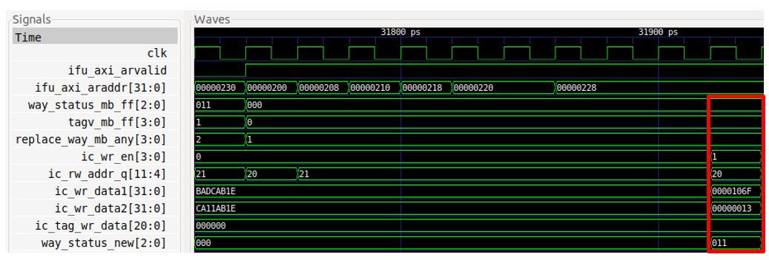
RVfpga Lab 19: I$ Replacement Policy – 1st Jump
The first jump’s address (0x200) maps to Set 8 of the I$. That set is initially empty, thus, the new block must be written in Way 0: replace_way_mb_any = ic_wr_en = 0001. The LRU state of Set 8 is updated as follows: way_status_new = 011.
The I$ block is read from the DDR Memory and written into the I$ in 64-bit chunks. The figure illustrates the write of the tag and the two first instructions of the new block into SET 8:
ic_rw_addr_q[11:4] = 00100000 (SET 8)
ic_tag_wr_data[19:0] = 0x0
ic_wr_data1[31:0] = 0x0000106F (j Set8_Block2)
ic_wr_data2[31:0] = 0x00000013 (nop)

Slide 253
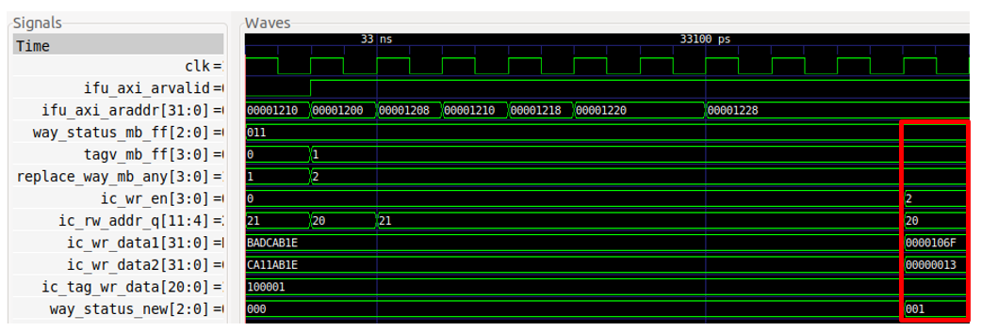
RVfpga Lab 19: I$ Replacement Policy – 2nd Jump
The second jump’s address (0x1200) also maps to Set 8 of the I$. Only way 0 is valid in that set: tagv_mb_ff = 0001. Thus, the new block must be written in Way 1: replace_way_mb_any = ic_wr_en = 0010. The LRU state of Set 8 is updated as follows: way_status_new = 001.
The I$ block is read from the DDR Memory and written into the I$ in 64-bit chunks. The figure illustrates the write of the tag and the two first instructions of the new block into SET 8:
ic_rw_addr_q[11:4] = 00100000 (SET 8)
ic_tag_wr_data[19:0] = 0x1
ic_wr_data1[31:0] = 0x0000106F (j Set8_Block3)
ic_wr_data2[31:0] = 0x00000013 (nop)

Slide 254
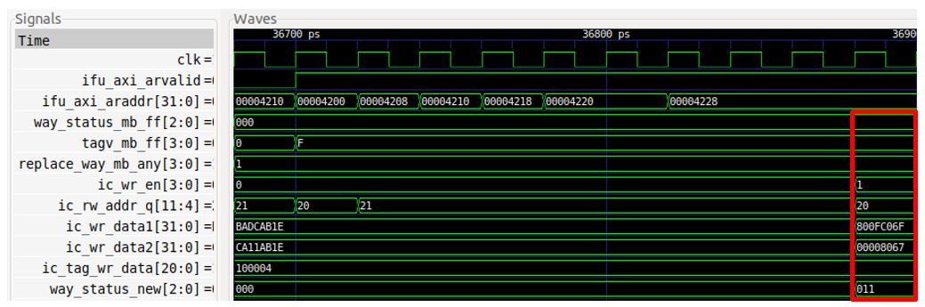
RVfpga Lab 19: I$ Replacement Policy – 5th Jump
The fifth jump’s address (0x4200) also maps to Set 8 of the I$. However, in this case the set is full: tagv_mb_ff = 1111. Thus, the new block must be written to Way 1: replace_way_mb_any = ic_wr_en = 0001. The LRU state of Set 8 is updated as follows: way_status_new = 011.
The I$ block is read from the DDR Memory and written into the I$ in 64-bit chunks. The figure illustrates the write of the tag and the two first instructions of the new block into SET 8:
ic_rw_addr_q[11:4] = 00100000 (SET 8)
ic_tag_wr_data[19:0] = 0x4
ic_wr_data1[31:0] = 0x800fc06f (j Set8_Block1)
ic_wr_data2[31:0] = 0x00008067 (ret)

Slide 255
RVfpga Lab 19: Tasks and Exercises – Sample
TASK: Using the HW Counters, measure the number of cycles, instructions, loads and stores in the program from Figure 2. How much time in total (both for reading and writing) does it take to access the DDR External Memory?
TASK: Use the example from [RVfpgaPath]/RVfpga/Labs/Lab19/LW_Instruction_ExtMem to estimate the DDR External Memory read latency using the HW Counters.
TASK: A quite complex but very interesting exercise is to analyse the Memory Controller used in the RVfpga System. Remember that you can find the modules that make up this controller in folder [RVfpgaPath]/RVfpga/src/LiteDRAM, and that the top module is implemented in file litedram_top.v inside that folder. You can start with the simulation from Figure 3 and add and analyse some signals from the LiteDRAM controller.
Exercise 4) Analyse in simulation and on the board other I$ configurations, such as an I$ with a different block size. Recall that the number of ways cannot be modified.
Exercise 5) Analyse the logic that checks the correctness of the parity information from the Data Array and from the Tag Array.

Slide 256
Lab 20: ICCM, DCCM, and Benchmarking

Slide 257
RVfpga Lab 20: ICCM, DDCM & Benchmarking
Scratchpad memories:
Instruction Closely-Coupled Memory (ICCM)
Data Closely-Coupled Memory (DCCM)

Slide 258
RVfpga Lab 20: Address Space (Instructions)

Slide 259
RVfpga Lab 20: Address Space (Data)
External memory (~22 cycles):
0x00000000 – 0x07FFFFFF
On-chip memory (DCCM, ~1 cycle):
0xF0040000 – 0xF004FFFF

Slide 260
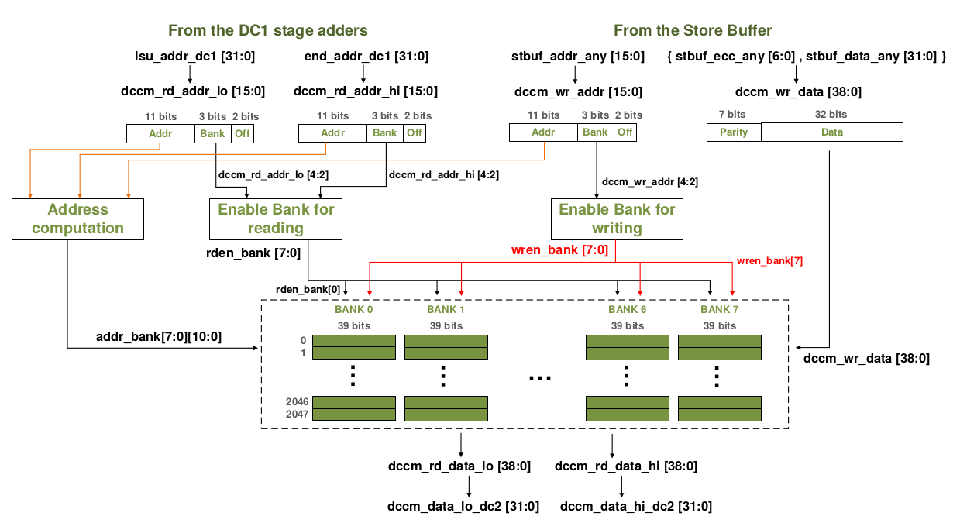
RVfpga Lab 20: ICCM Configuration and Operation

Slide 261
RVfpga Lab 20: Accessing the ICCM – Example
// Access array
la t4, D
li t5, 50
li t0, 1000
la t6, D
add t6, t6, t0
li t5, 1
REPEAT_Access:
lw t3, (t4)
add t3, t3, t5
sw t3, (t4)
add t4, t4, 4
INSERT_NOPS_10
INSERT_NOPS_10
bne t4, t6, REPEAT_Access

Slide 262
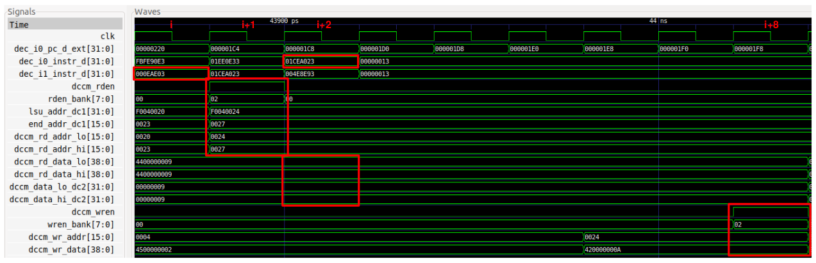
RVfpga Lab 20: Accessing the ICCM – Example

Slide 263
RVfpga Lab 20: Accessing the ICCM – Example
Cycle i: The lw instruction is decoded in Way 1: dec_i1_instr_d = 0x000eae03.
Cycle i+1: The address is generated in the DC1 stage and provided to the DCCM. As a result of the address check, reading the DCCM is enabled: dccm_rden = 1. This signal is provided to the DCCM and, along with the 3-bit Bank field of the address, determines the bank that must be read.
Cycle i+2: The read data is obtained from the DCCM and provided to the core.
Cycle i+8: After adding 1 (the immediate) to the read value (0x00000009 + 1 = 0x0000000A) and traversing the Store Buffer, as explained in Lab 13, the data and address are provided to the DCCM, and writing of the correct bank is enabled.

Slide 264
RVfpga Lab 20: Benchmarking
Benchmarks:
Run set of programs on processor
Compare processors
Two common benchmarks:
CoreMark
Dhrystone
Benchmarks use hardware counters (HW Counters) to measure events (such as number of instructions, number of cycles).

Slide 265
RISC-V Hardware Counters
Special-purpose registers to record performance and other metrics (shown below).
Table 7-2 in SweRV EH1 Programmer’s Reference Manual: https://github.com/chipsalliance/Cores-SweRV/blob/master/docs/RISC-V_SweRV_EH1_PRM.pdf

Slide 266
How to Use and Initialize Hardware Counters
Include Western Digital’s PSP (Platform Support Package):
#include <psp_api.h>
Enable counters:
pspEnableAllPerformanceMonitor(1);
Set counters to measure various metrics:
pspPerformanceCounterSet(D_PSP_COUNTER0, E_CYCLES_CLOCKS_ACTIVE);
pspPerformanceCounterSet(D_PSP_COUNTER1, E_INSTR_COMMITTED_ALL);
Read metrics:
cyc_end = pspPerformanceCounterGet(D_PSP_COUNTER0);
instr_end = pspPerformanceCounterGet(D_PSP_COUNTER1);
Print metrics:
printfNexys("Cycles = %d", cyc_end - cyc_beg);
printfNexys("Instructions = %d", instr_end - instr_beg);

Slide 267
Example Program with Hardware Counters
// Also include board support package (bsp) header files) – see Lab 20 files
#include <psp_api.h>
int main(void) {
int cyc_beg, cyc_end, instr_beg, instr_end;
uartInit();
pspEnableAllPerformanceMonitor(1); // enable counters
pspPerformanceCounterSet(D_PSP_COUNTER0, E_CYCLES_CLOCKS_ACTIVE); // assign
pspPerformanceCounterSet(D_PSP_COUNTER1, E_INSTR_COMMITTED_ALL); // counters
cyc_beg = pspPerformanceCounterGet(D_PSP_COUNTER0); // read counters
instr_beg = pspPerformanceCounterGet(D_PSP_COUNTER1);
Test_Assembly();
cyc_end = pspPerformanceCounterGet(D_PSP_COUNTER0); // read counters
instr_end = pspPerformanceCounterGet(D_PSP_COUNTER1);
printfNexys("Cycles = %d", cyc_end-cyc_beg); // print values
printfNexys("Instructions = %d", instr_end-instr_beg);
}

Slide 268
RVfpga Lab 20: Metrics
CoreMark Metrics
CoreMark runs multiple iterations of a loop.
CoreMark Score (CM): The number of iterations it completes per second (i.e., the iterations/second).
CM/MHz: CM divided by the clock frequency in MHz (also called Iterat/Sec/MHz or iterations/second/MHz).
Recall, ideal IPC (instructions per cycle) is 2 for SweRV EH1 because it is 2-way superscalar.

Slide 269
RVfpga Lab 20: CoreMark Performance
 | Compiler = debug External Memory | Compiler = debug DCCM | Compiler = optimized DCCM
CM/MHz | 0.47 | 1.88 | 3.47
# Instructions | ~0.5 million | ~0.5 million | 0.309 million
# Cycles | ~2 million | ~0.5 million | 0.288 million
IPC (instructions/cycle) | 0.25 | ~1 | ~1
Data Bus Transactions | ~133,000 (all go to external memory) | 0 (due to DCCM) | 0 (due to DCCM)
Instruction Bus Transactions | 392 (due to I$) | 392 (due to I$) | 392 (due to I$)

Slide 270
RVfpga Lab 20: Tasks and Exercises – Sample
TASK: Using the instructions provided in Lab 1, implement a new RVfpga System that includes a 64 KiB ICCM.
TASK: Simulate an unaligned read to the DCCM and analyse how it is handled inside the DCCM.
TASK: Simulate a DCCM bank conflict by modifying the program from Figure 4.
TASK: Modify file platformio.ini to use both the DCCM for storing most data and the ICCM for storing the instructions. Execute the CoreMark benchmark and compare the results with the ones obtained in this section.
TASK: Modify the compilation optimization to -O3 and explain the results.
Exercise 1) Do the same analysis as was done for CoreMark but this time using the Dhrystone benchmark.
Exercise 2) Do the same analysis as was done for CoreMark but this time for the ImageProcessing application from Lab 4.
Exercise 3) Enable/disable various core features. Compare the performance results. Run all three programs (CoreMark, Dhrystone, and ImageProcessing) on these modified RVfpga Systems on the Nexys A7 board.

Slide 271
Acknowledgements
AUTHORS
Prof. Sarah Harris
Prof. Daniel Chaver
Zubair Kakakhel
M. Hamza Liaqat
CONTRIBUTORS
Robert Owen
Olof Kindgren
Prof. Luis Piñuel
Ivan Kravets
Valerii Koval
Ted Marena
Prof. Roy Kravitz
Prof. Peng Liu
ASSOCIATES
Prof. José Ignacio Gómez
Prof. Christian Tenllado
Prof. Daniel León
Prof. Katzalin Olcoz
Prof. Alberto del Barrio
Prof. Fernando Castro
Prof. Manuel Prieto
Prof. Francisco Tirado
Prof. Román Hermida
Prof. Julio Villalba
Prof Ataur Patwary
Cathal McCabe
Dan Hugo
Braden Harwood
Prof. David Burnett
Gage Elerding
Prof. Brian Cruickshank
Deepen Parmar
Thong Doan
Oliver Rew
Niko Nikolay
Guanyang He
Prof. Peng Liu
ADVISER
Prof. David Patterson
Sponsors and Supporters

